Slide 1




Short-range correlation physics at low RG resolution
Anthony Tropiano¹, Scott Bogner², Dick Furnstahl¹
¹Ohio State University, ²Michigan State University
APS DNP Meeting – Virtual Meeting
October 12, 2021
ajt, S.K. Bogner, and R.J. Furnstahl, arXiv:2105.13936
Phys. Rev. C 104, 034311 (2021)

Slide 2
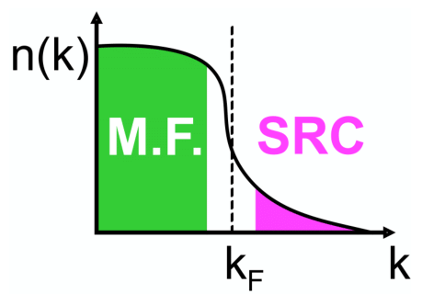
Motivation
knock-out 2 high-k nucleons
Recent experiments have been able to isolate processes where short-range correlation (SRC) physics is dominant and well accounted for by SRC phenomenology
SRC physics at high RG resolution
SRC pairs are components in the nuclear wave function with relative momenta above the Fermi momentum
excite SRC pair
same expt. resolution
low-k initial pair
Notes:
Read first bullet, define high RG resolution picture explaining cartoon in the process, and explain electron scattering diagram.
Mention GCF after first bullet.

Slide 3
Motivation
knock-out 2 high-k nucleons
Recent experiments have been able to isolate processes where short-range correlation (SRC) physics is dominant and well accounted for by SRC phenomenology
SRC physics at low RG resolution
The SRC physics is shifted into the reaction operators from the nuclear wave function (which becomes soft)
Operators do not become hard, which simplifies calculations
excite SRC pair
same expt. resolution
low-k initial pair
Notes:
Explain low RG resolution picture (read bullets), explain low RG resolution electron scattering.

Slide 4
Motivation
knock-out 2 high-k nucleons
Recent experiments have been able to isolate processes where short-range correlation (SRC) physics is dominant and well accounted for by SRC phenomenology
SRC physics at low RG resolution
The SRC physics is shifted into the reaction operators from the nuclear wave function (which becomes soft)
Operators do not become hard, which simplifies calculations
Experimental resolution (set by momentum of probe) is the same in both pictures
Same observables but different physical interpretation!
excite SRC pair
same expt. resolution
low-k initial pair
Notes:
Comparison of pictures: same experimental resolution, same observables, but different physical interpretation.

Slide 5
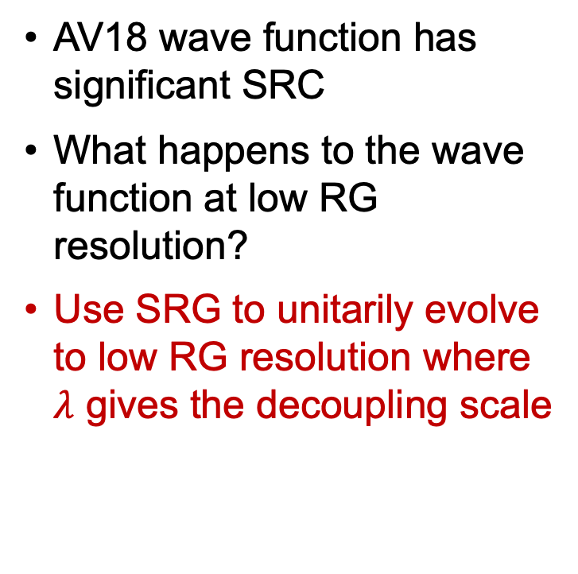
Similarity Renormalization Group (SRG)
SRC in AV18
AV18 wave function has significant SRC
What happens to the wave function at low RG resolution?
Use SRG to unitarily evolve to low RG resolution where $λ$ gives the decoupling scale
S-state
D-state
Fig. 1: SRG evolution of deuteron wave function in coordinate space for AV18 and Gezerlis N²LO¹.
¹A. Gezerlis et al., Phys. Rev. C 90, 054323 (2014)
Notes:
Consider deuteron wave function in coordinate space as an example, unevolved significant SRC, use SRG to go to low RG resolution.

Slide 6
Similarity Renormalization Group (SRG)
SRC in AV18
No SRC
SRC physics in AV18 is gone from wave function at low RG resolution
Deuteron wave functions become soft and D-state probability goes down
Observables such as asymptotic D-S ratio are the same
SRG evolved
S-state
S-state
D-state
D-state
Fig. 1: SRG evolution of deuteron wave function in coordinate space for AV18 and Gezerlis N²LO¹.
¹A. Gezerlis et al., Phys. Rev. C 90, 054323 (2014)
Notes:
At low RG resolution, SRC physics in AV18 wave function is gone, both curves collapse on one another, D-state probability is suppressed, but observables are the same.

Slide 7
Momentum distributions at low RG resolution
Soft wave functions at low RG resolution
Where does the SRC physics go?
Notes:
Ask question.

Slide 8
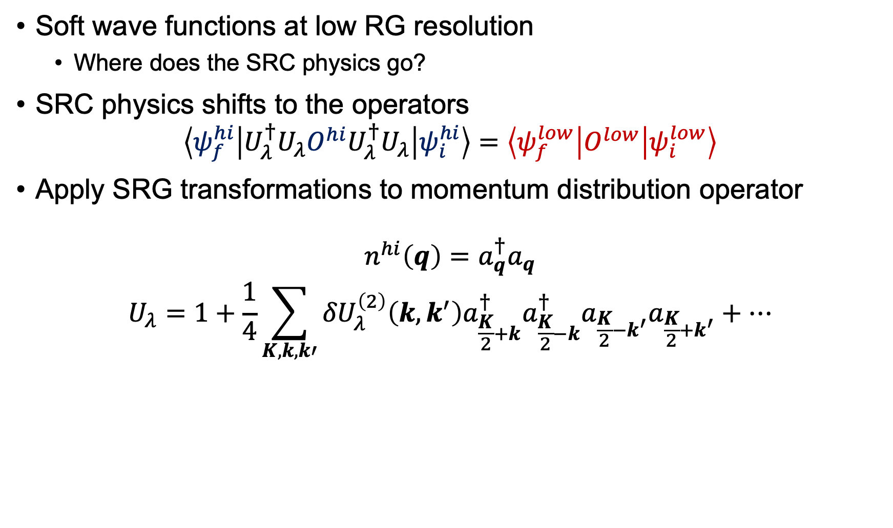
Momentum distributions at low RG resolution
Soft wave functions at low RG resolution
Where does the SRC physics go?
SRC physics shifts to the operators
$$\left\langle ψ_{f}^{hi} | U_{λ}^{†}U_{λ}O^{hi}U_{λ}^{†}U_{λ} | ψ_{i}^{hi}\right\rangle =\left\langle ψ_{f}^{low} | O^{low} | ψ_{i}^{low}\right\rangle$$
Apply SRG transformations to momentum distribution operator
$$n^{hi}\left(q\right)=a_{q}^{†}a_{q}$$
$$U_{λ}=1+\frac{1}{4}\sum_{K,k,k′}{{δU}_{λ}^{\left(2\right)}\left(k,k^{′}\right)a_{\frac{K}{2}+k}^{†}a_{\frac{K}{2}−k}^{†}a_{\frac{K}{2}−k^{′}}a_{\frac{K}{2}+k^{′}}+⋯}$$
Notes:
Answer: consider the matrix element -> SRC physics goes to operator. We will apply the transformation up to two-body on momentum distribution operator.

Slide 9
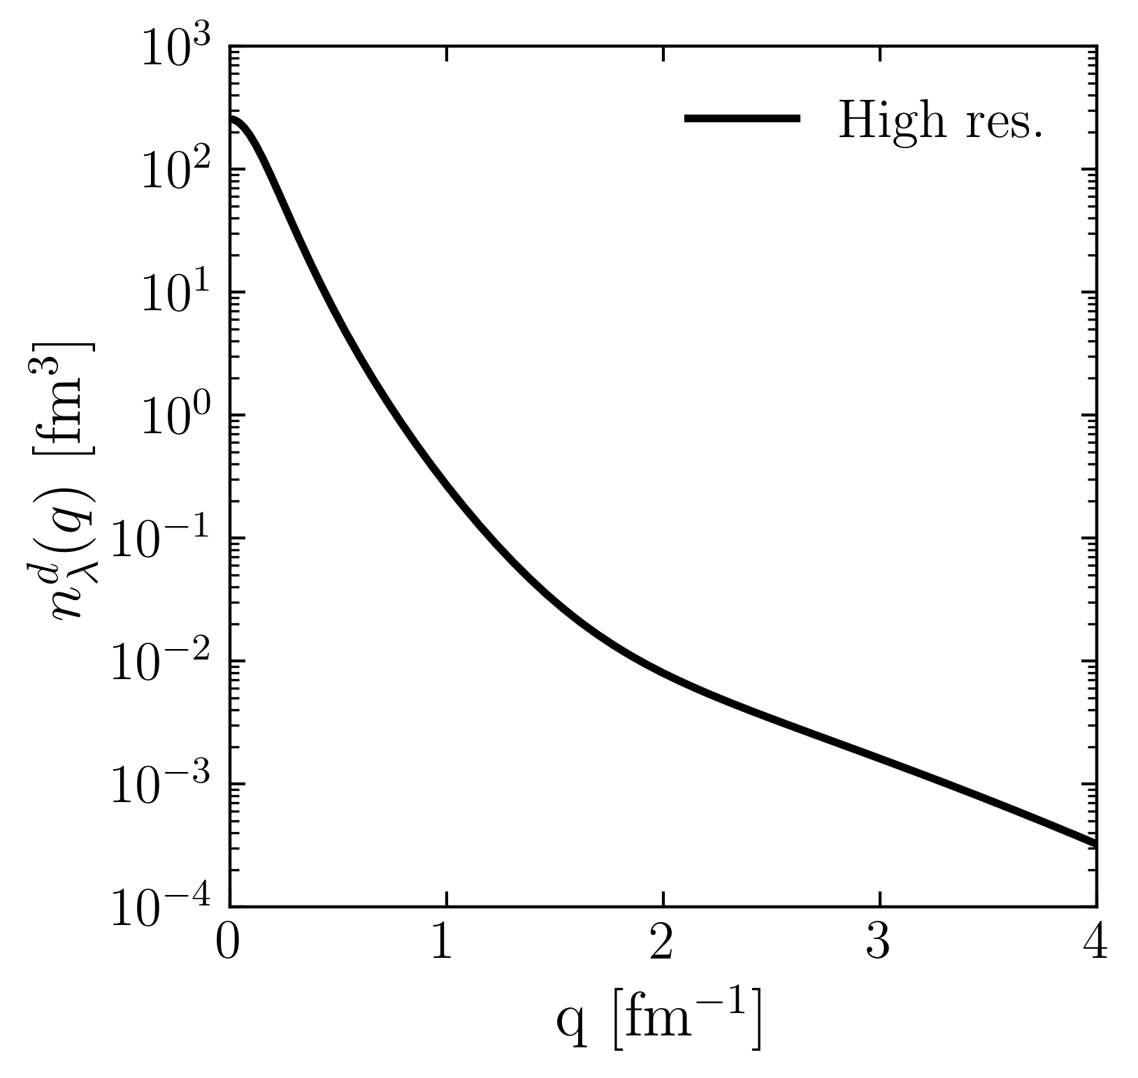
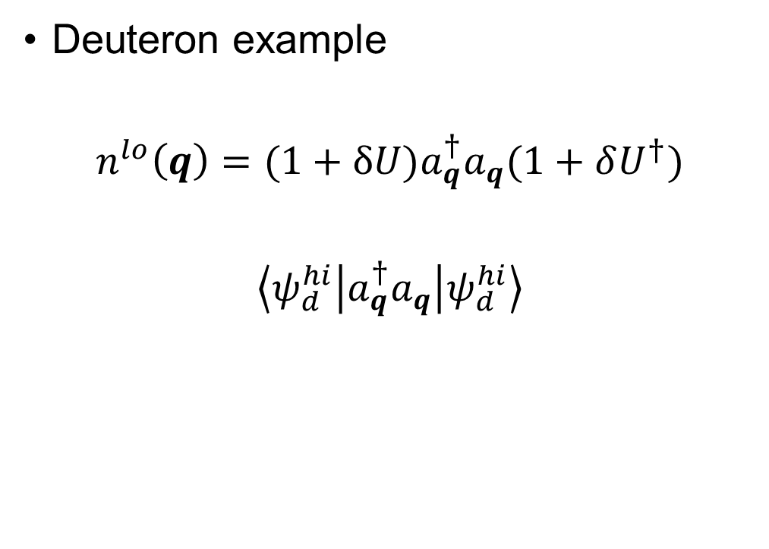
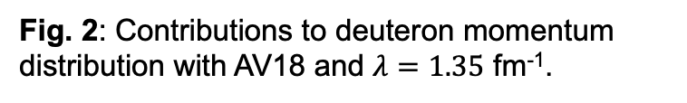
Momentum distributions at low RG resolution
Deuteron example
$$n^{lo}\left(q\right)=(1+δU)a_{q}^{†}a_{q}(1+δU^{†})$$
$$\left\langle ψ_{d}^{hi} | a_{q}^{†}a_{q} | ψ_{d}^{hi}\right\rangle$$
Fig. 2: Contributions to deuteron momentum distribution with AV18 and $λ=1.35$ fm⁻¹.
Notes:
Use deuteron in momentum space as an example and consider contributions to the full distribution in terms of 1 and \delta U. Here is the full result.

Slide 10
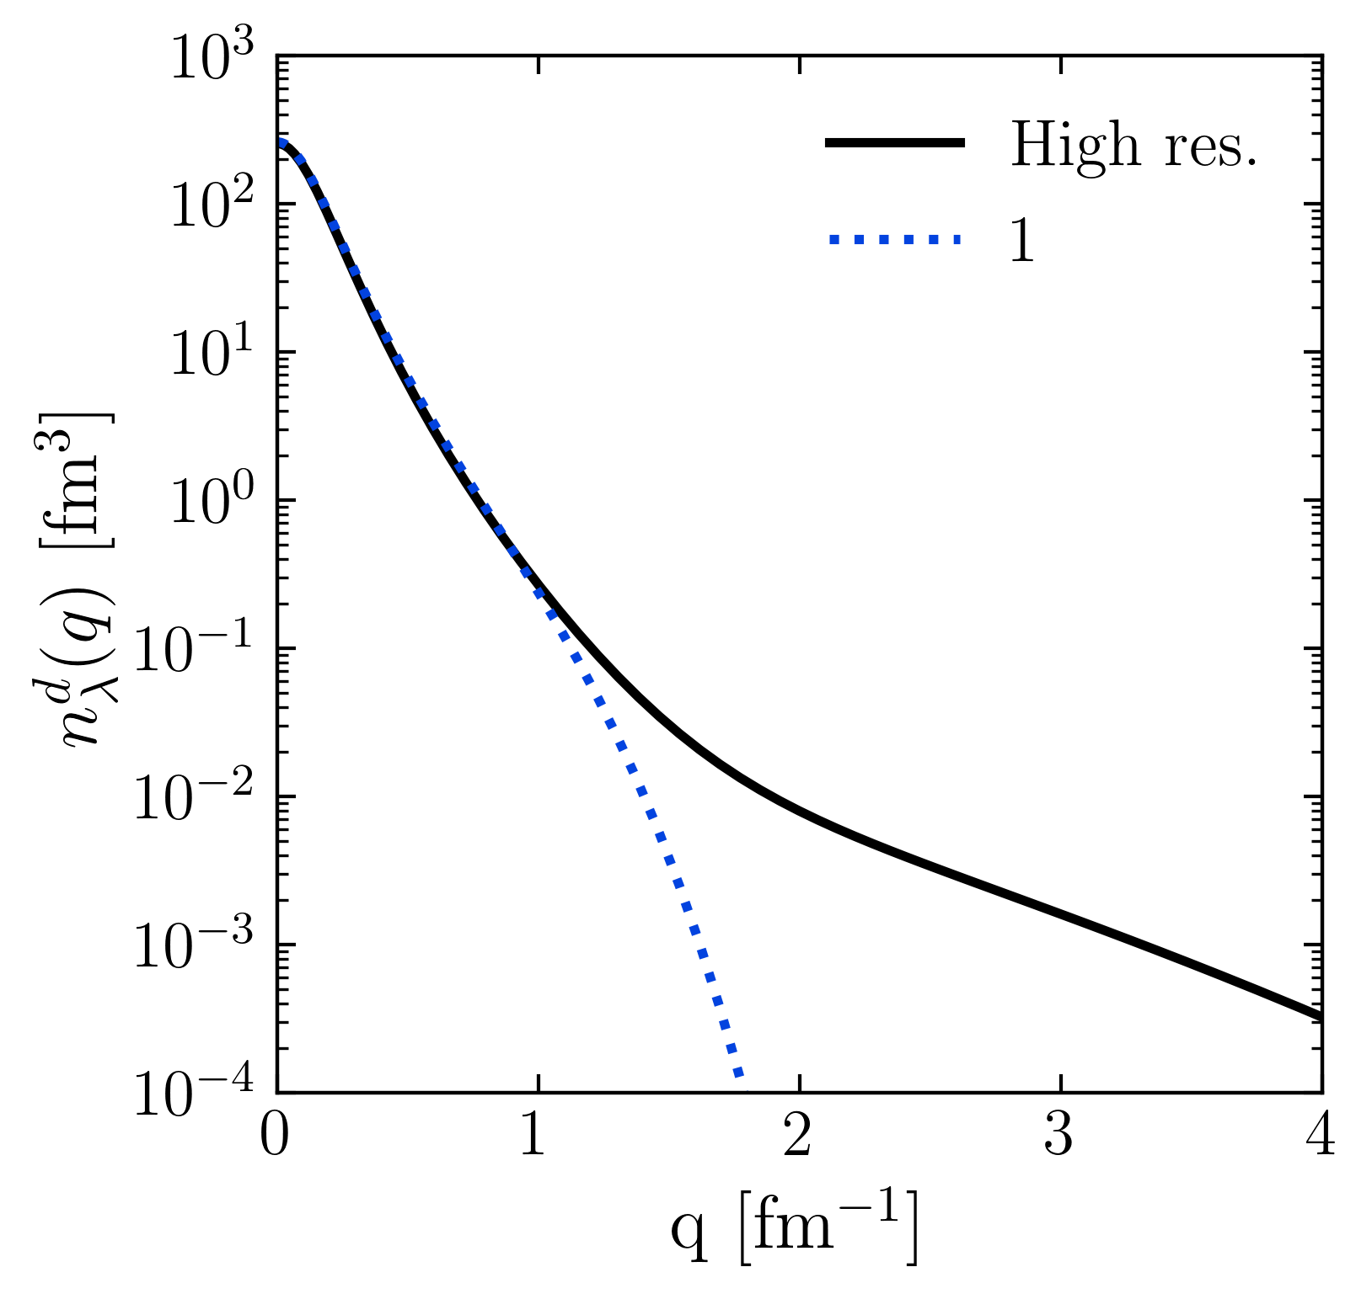
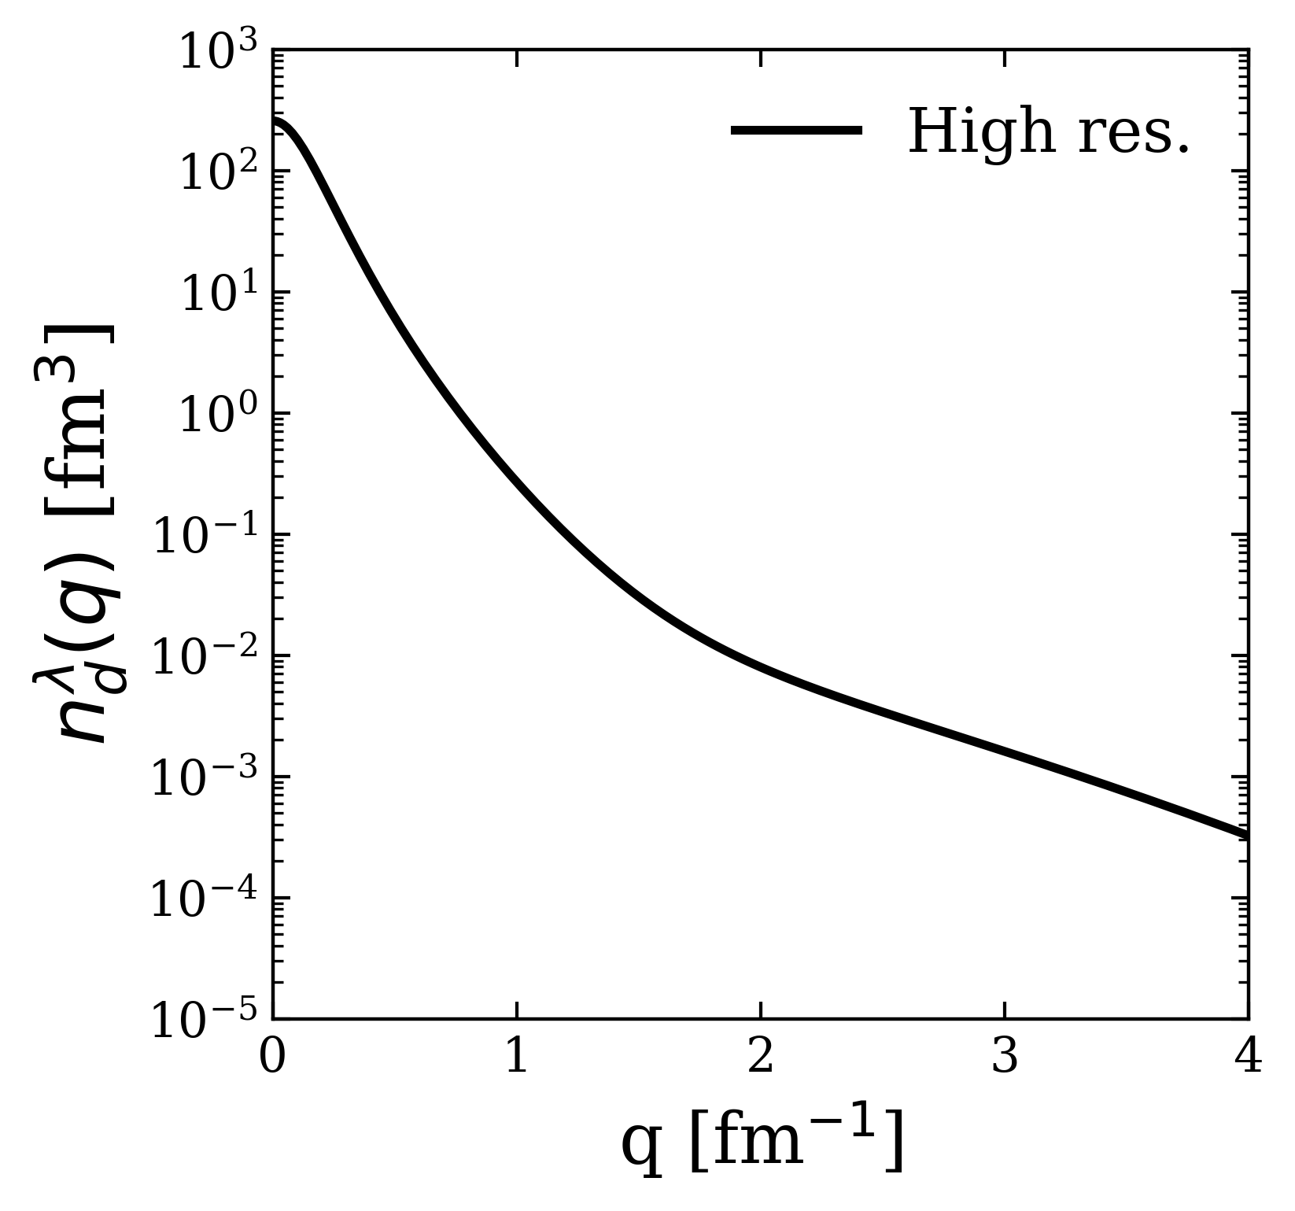
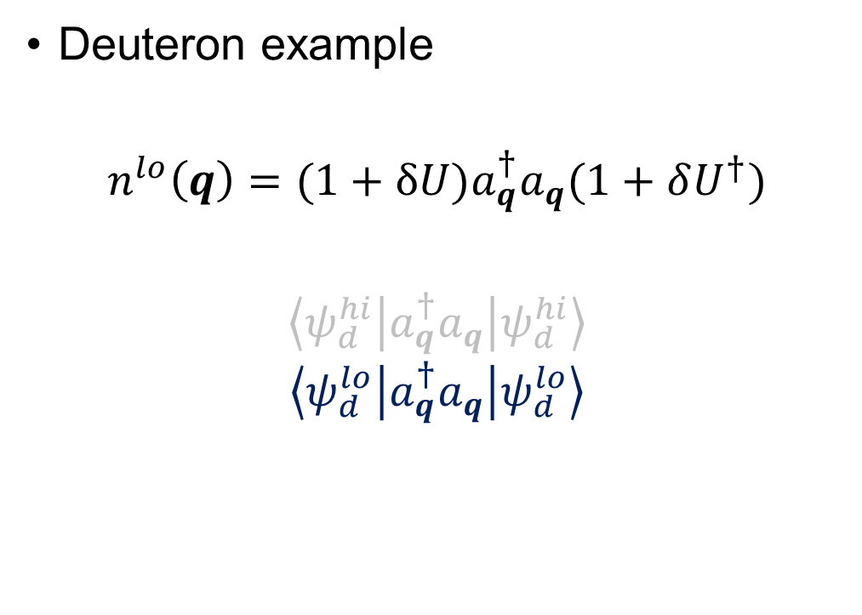
Momentum distributions at low RG resolution
Deuteron example
$$n^{lo}\left(q\right)=(1+δU)a_{q}^{†}a_{q}(1+δU^{†})$$
$$\left\langle ψ_{d}^{hi} | a_{q}^{†}a_{q} | ψ_{d}^{hi}\right\rangle$$
$$\left\langle ψ_{d}^{lo} | a_{q}^{†}a_{q} | ψ_{d}^{lo}\right\rangle$$
Fig. 2: Contributions to deuteron momentum distribution with AV18 and $λ=1.35$ fm⁻¹.
Notes:
Taking only 1.

Slide 11
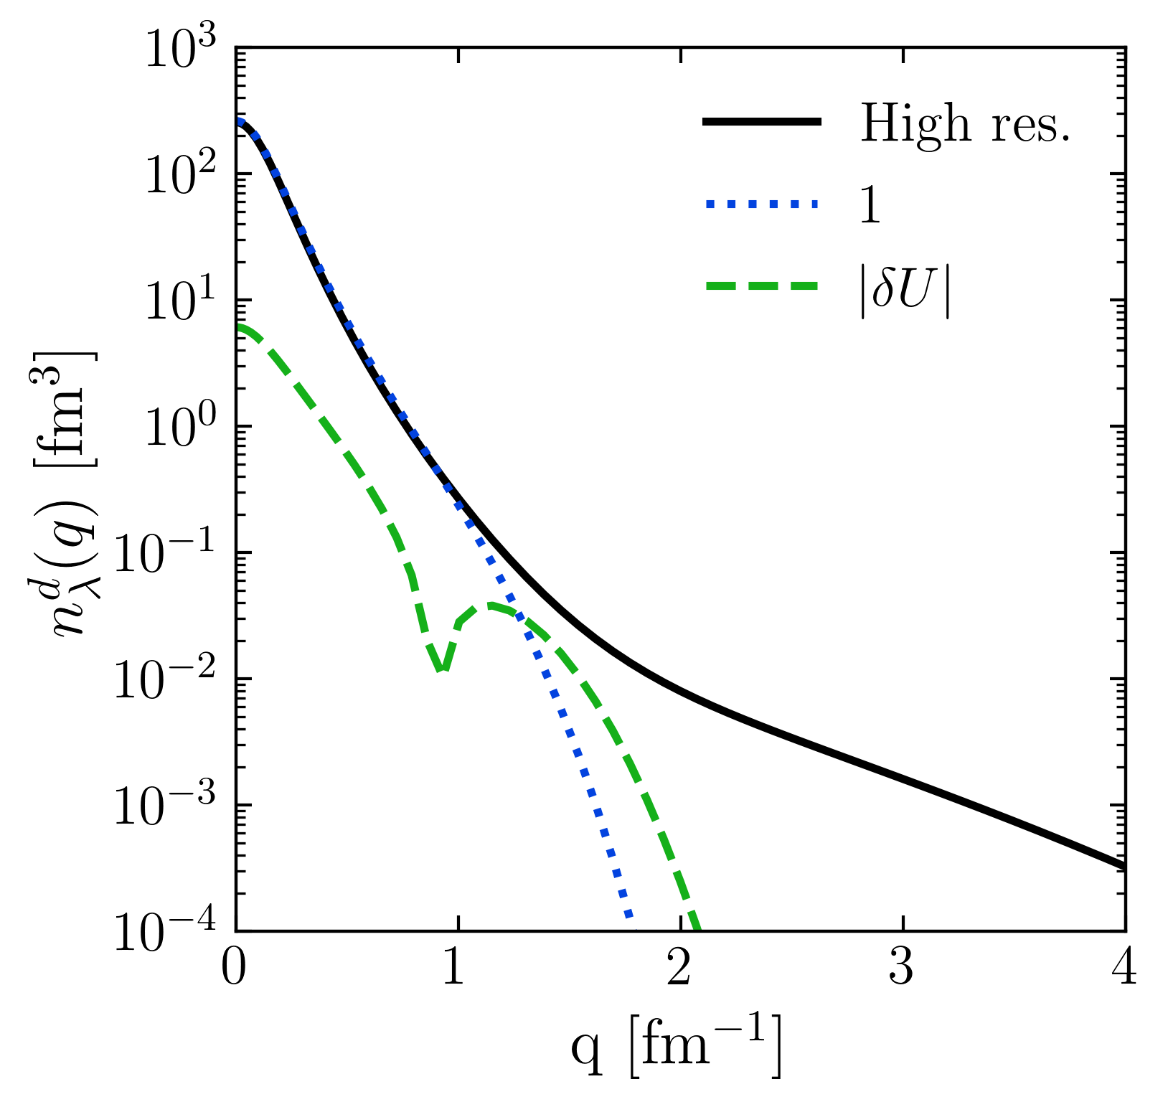
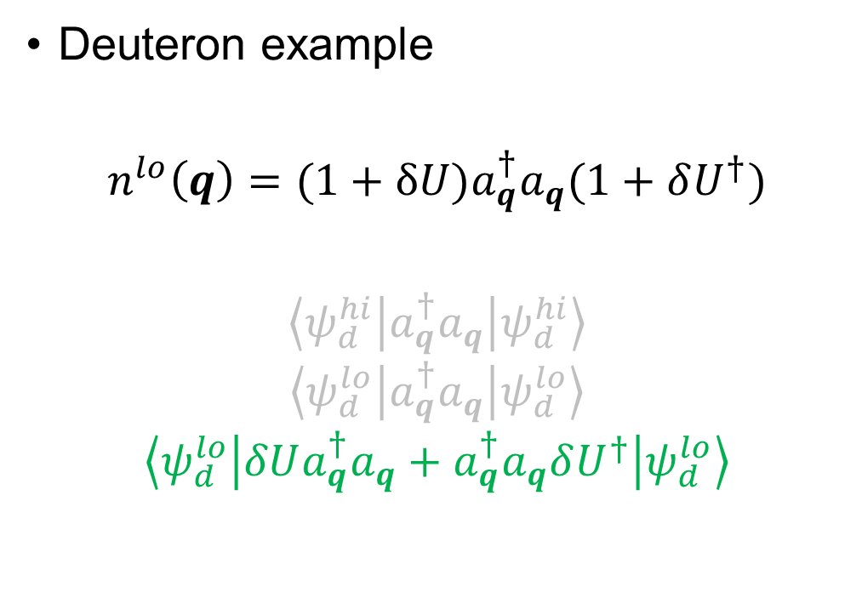
Momentum distributions at low RG resolution
Deuteron example
$$n^{lo}\left(q\right)=(1+δU)a_{q}^{†}a_{q}(1+δU^{†})$$
$$\left\langle ψ_{d}^{hi} | a_{q}^{†}a_{q} | ψ_{d}^{hi}\right\rangle$$
$$\left\langle ψ_{d}^{lo} | a_{q}^{†}a_{q} | ψ_{d}^{lo}\right\rangle$$
$$\left\langle ψ_{d}^{lo} | δUa_{q}^{†}a_{q}+a_{q}^{†}a_{q}δU^{†} | ψ_{d}^{lo}\right\rangle$$
Fig. 2: Contributions to deuteron momentum distribution with AV18 and $λ=1.35$ fm⁻¹.
Notes:
Taking only \delta U.

Slide 12
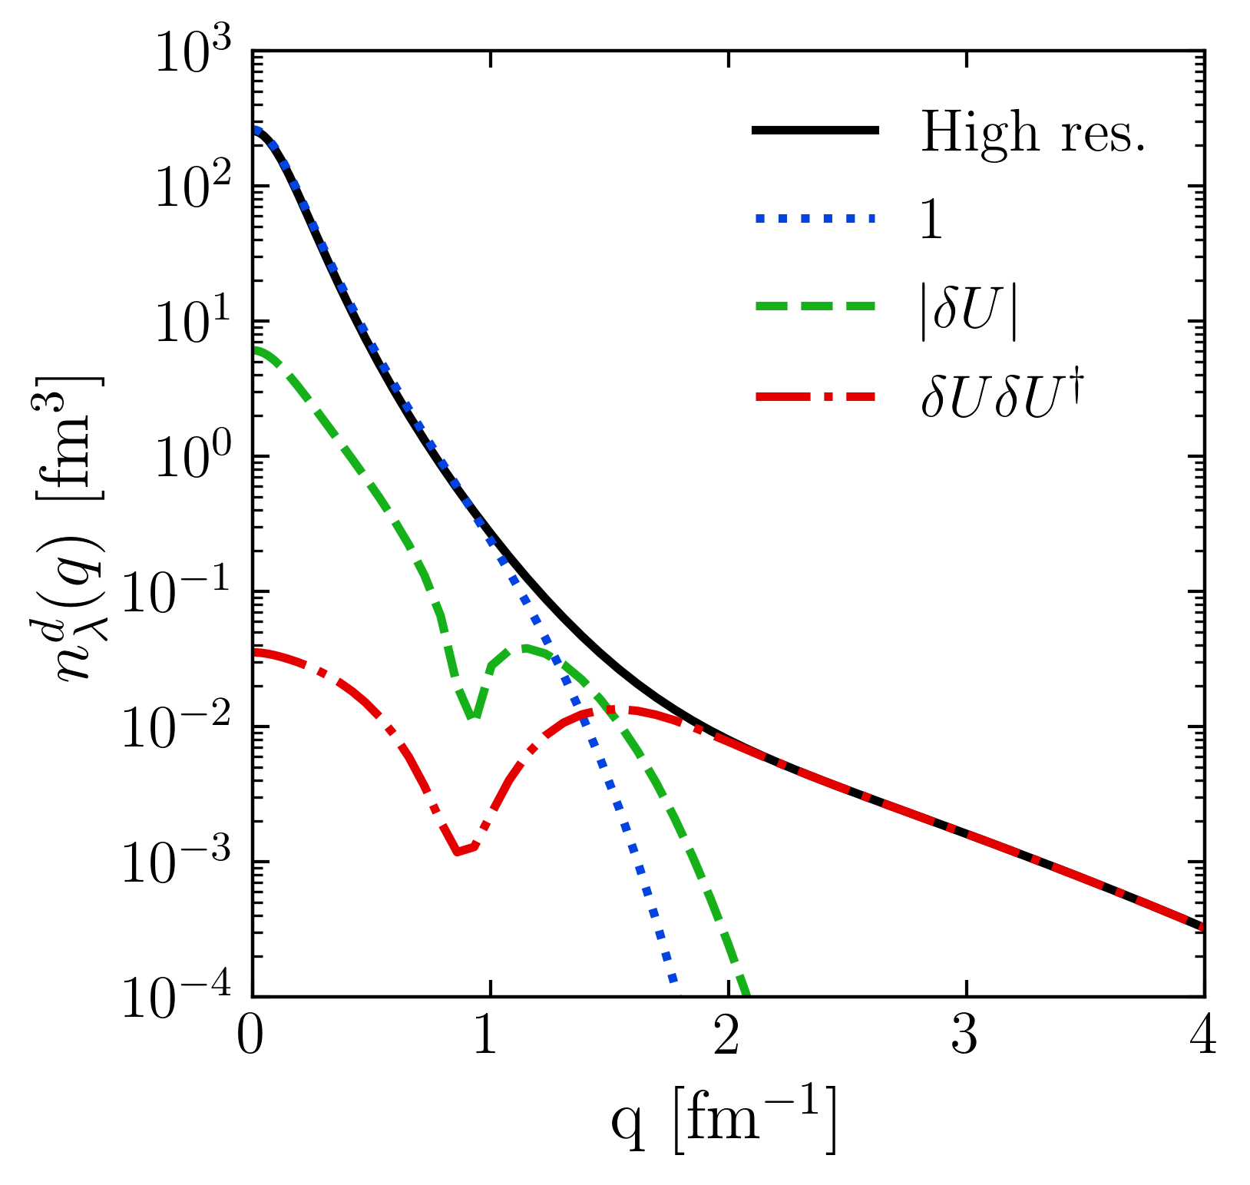
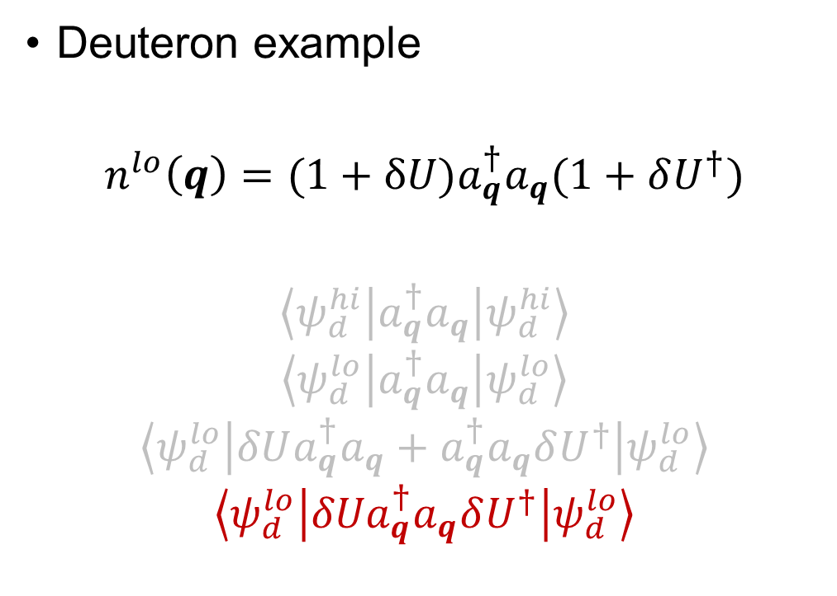
Momentum distributions at low RG resolution
Deuteron example
$$n^{lo}\left(q\right)=(1+δU)a_{q}^{†}a_{q}(1+δU^{†})$$
$$\left\langle ψ_{d}^{hi} | a_{q}^{†}a_{q} | ψ_{d}^{hi}\right\rangle$$
$$\left\langle ψ_{d}^{lo} | a_{q}^{†}a_{q} | ψ_{d}^{lo}\right\rangle$$
$$\left\langle ψ_{d}^{lo} | δUa_{q}^{†}a_{q}+a_{q}^{†}a_{q}δU^{†} | ψ_{d}^{lo}\right\rangle$$
$$\left\langle ψ_{d}^{lo} | {δUa}_{q}^{†}a_{q}δU^{†} | ψ_{d}^{lo}\right\rangle$$
Fig. 2: Contributions to deuteron momentum distribution with AV18 and $λ=1.35$ fm⁻¹.
Notes:
Taking \delta U \delta U^\dagger -> gives high-momentum tail.

Slide 13
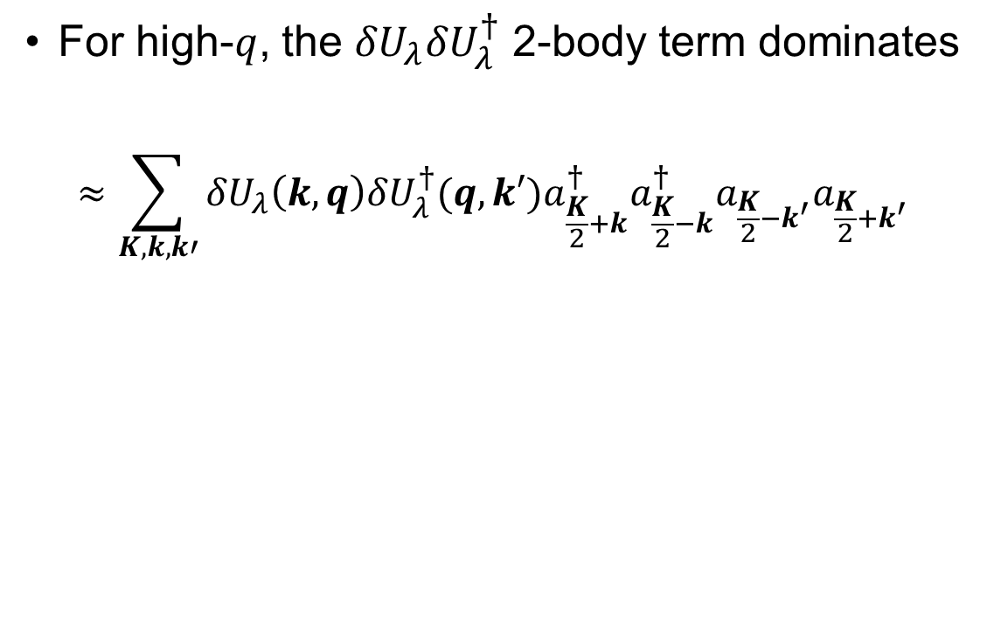
Momentum distributions at low RG resolution
For high-$q$, the ${δU}_{λ}{δU}_{λ}^{†}$ 2-body term dominates
$$≈\sum_{K,k,k′}{{δU}_{λ}\left(k,q\right){{δU}_{λ}^{†}(q,k′)a}_{\frac{K}{2}+k}^{†}a_{\frac{K}{2}−k}^{†}a_{\frac{K}{2}−k^{′}}a_{\frac{K}{2}+k^{′}}}$$
Fig. 2: Contributions to deuteron momentum distribution with AV18 and $λ=1.35$ fm⁻¹.
Notes:
Read bullet.

Slide 14
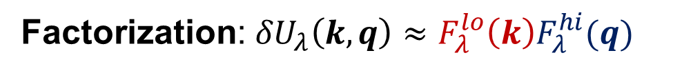
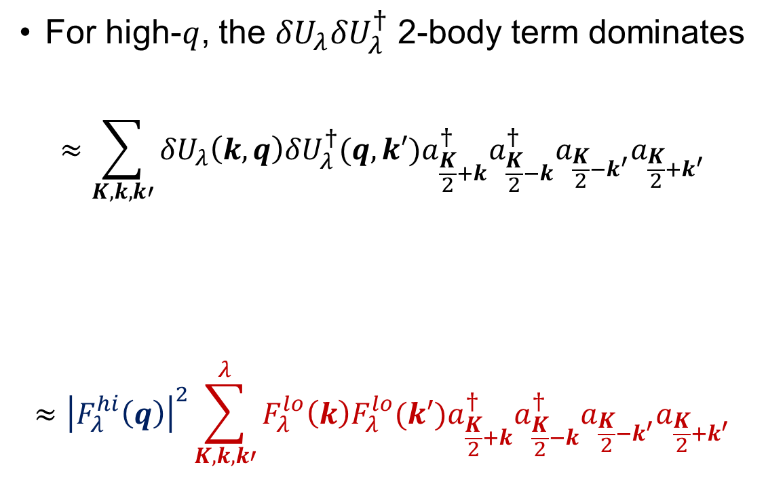
Momentum distributions at low RG resolution
For high-$q$, the ${δU}_{λ}{δU}_{λ}^{†}$ 2-body term dominates
$$≈\sum_{K,k,k′}{{δU}_{λ}\left(k,q\right){{δU}_{λ}^{†}(q,k′)a}_{\frac{K}{2}+k}^{†}a_{\frac{K}{2}−k}^{†}a_{\frac{K}{2}−k^{′}}a_{\frac{K}{2}+k^{′}}}$$
$$≈{\left|F_{λ}^{hi}\left(q\right)\right|}^{2}\sum_{K,k,k′}^{λ}{F_{λ}^{lo}\left(k\right){F_{λ}^{lo}(k′)a}_{\frac{K}{2}+k}^{†}a_{\frac{K}{2}−k}^{†}a_{\frac{K}{2}−k^{′}}a_{\frac{K}{2}+k^{′}}}$$
Factorization: ${δU}_{λ}\left(k,q\right)≈F_{λ}^{lo}{\left(k\right)F}_{λ}^{hi}(q)$
Fig. 2: Contributions to deuteron momentum distribution with AV18 and $λ=1.35$ fm⁻¹.
Notes:
Furthermore, this factorizes so we are left with the high-momentum dependence out in front here (point) and the rest is at low momentum.
Factorization from OPE.

Slide 15

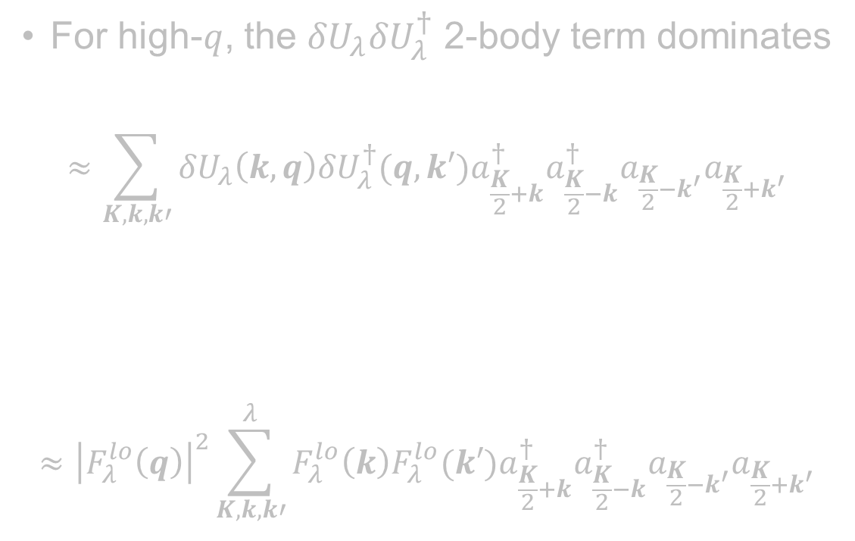
Momentum distributions at low RG resolution
For high-$q$, the ${δU}_{λ}{δU}_{λ}^{†}$ 2-body term dominates
$$≈\sum_{K,k,k′}{{δU}_{λ}\left(k,q\right){{δU}_{λ}^{†}(q,k′)a}_{\frac{K}{2}+k}^{†}a_{\frac{K}{2}−k}^{†}a_{\frac{K}{2}−k^{′}}a_{\frac{K}{2}+k^{′}}}$$
$$≈{\left|F_{λ}^{lo}\left(q\right)\right|}^{2}\sum_{K,k,k′}^{λ}{F_{λ}^{lo}\left(k\right){F_{λ}^{lo}(k′)a}_{\frac{K}{2}+k}^{†}a_{\frac{K}{2}−k}^{†}a_{\frac{K}{2}−k^{′}}a_{\frac{K}{2}+k^{′}}}$$
Apply this strategy to nuclear momentum distributions using local density approximation (LDA)!
Factorization: ${δU}_{λ}\left(k,q\right)≈F_{λ}^{lo}{\left(k\right)F}_{λ}^{hi}(q)$
Fig. 2: Contributions to deuteron momentum distribution with AV18 and $λ=1.35$ fm⁻¹.
Notes:
Read textbox.

Slide 16
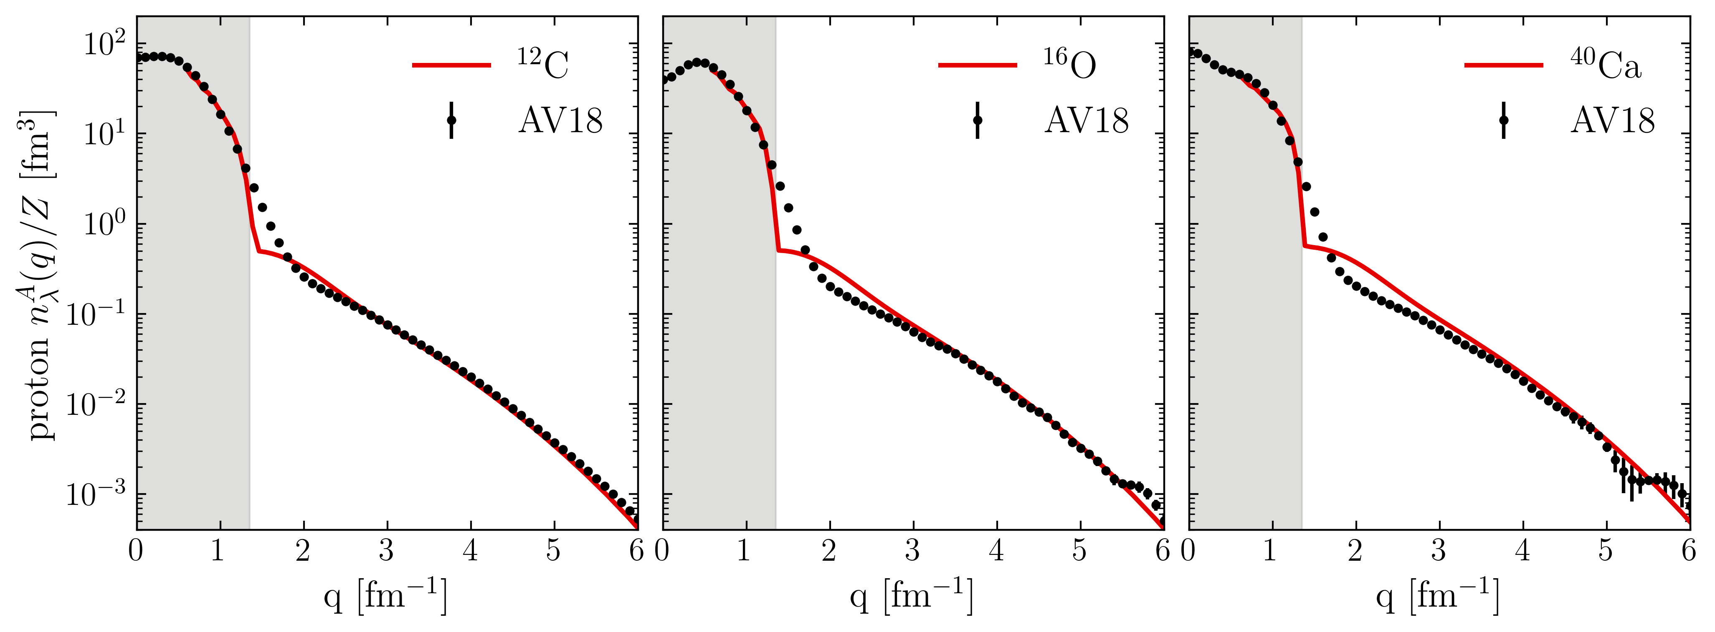
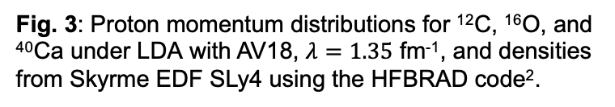
Proton momentum distributions
¹R.B. Wiringa et al., Phys. Rev. C 89, 024305 (2014)
https://www.phy.anl.gov/theory/research/momenta/
²K. Bennaceur et al., Comput. Phys. Commun. 168, 96 (2005)
Low RG resolution calculations reproduce momentum distributions of AV18 data¹ (high RG resolution calculation)
Fig. 3: Proton momentum distributions for ¹²C, ¹⁶O, and ⁴⁰Ca under LDA with AV18, $λ=1.35$ fm⁻¹, and densities from Skyrme EDF SLy4 using the HFBRAD code².
Notes:
Compare to AV18 QMC calculations
“We can get a good description of proton momentum distributions using just a Skyrme EDF (SLy4) and 2-body physics shifted into the operator”, emphasize that the high-q tail works well.
Why is the intermediate q region the worst? Operator cut at 2-body and WF is just HF. (IMSRG decoupling example).
Why isn’t low-q showing? Low-q corresponds to large-r in LDA where a local density approximation will not work.

Slide 17
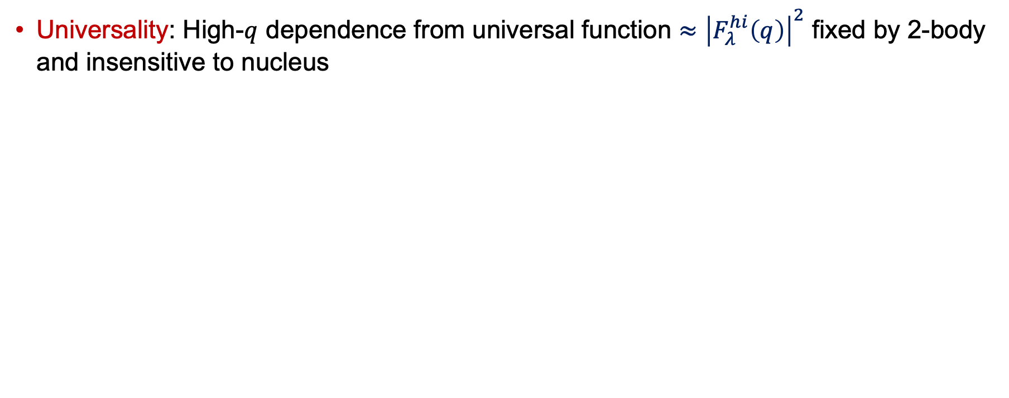
Proton momentum distributions
¹R.B. Wiringa et al., Phys. Rev. C 89, 024305 (2014)
https://www.phy.anl.gov/theory/research/momenta/
²K. Bennaceur et al., Comput. Phys. Commun. 168, 96 (2005)
Universality: High-$q$ dependence from universal function $≈{\left|F_{λ}^{hi}\left(q\right)\right|}^{2}$ fixed by 2-body and insensitive to nucleus
Fig. 3: Proton momentum distributions for ¹²C, ¹⁶O, and ⁴⁰Ca under LDA with AV18, $λ=1.35$ fm⁻¹, and densities from Skyrme EDF SLy4 using the HFBRAD code².
Notes:
High momentum dependence is fixed by 2-body and does not depend on the nucleus.

Slide 18
Proton momentum distributions
¹R.B. Wiringa et al., Phys. Rev. C 89, 024305 (2014)
https://www.phy.anl.gov/theory/research/momenta/
²K. Bennaceur et al., Comput. Phys. Commun. 168, 96 (2005)
Universality: High-$q$ dependence from universal function $≈{\left|F_{λ}^{hi}\left(q\right)\right|}^{2}$ fixed by 2-body and insensitive to nucleus
Low RG works well with simple approximations and is systematically improvable!
Fig. 3: Proton momentum distributions for ¹²C, ¹⁶O, and ⁴⁰Ca under LDA with AV18, $λ=1.35$ fm⁻¹, and densities from Skyrme EDF SLy4 using the HFBRAD code².
Notes:
The main takeaway is that the (read box).

Slide 19
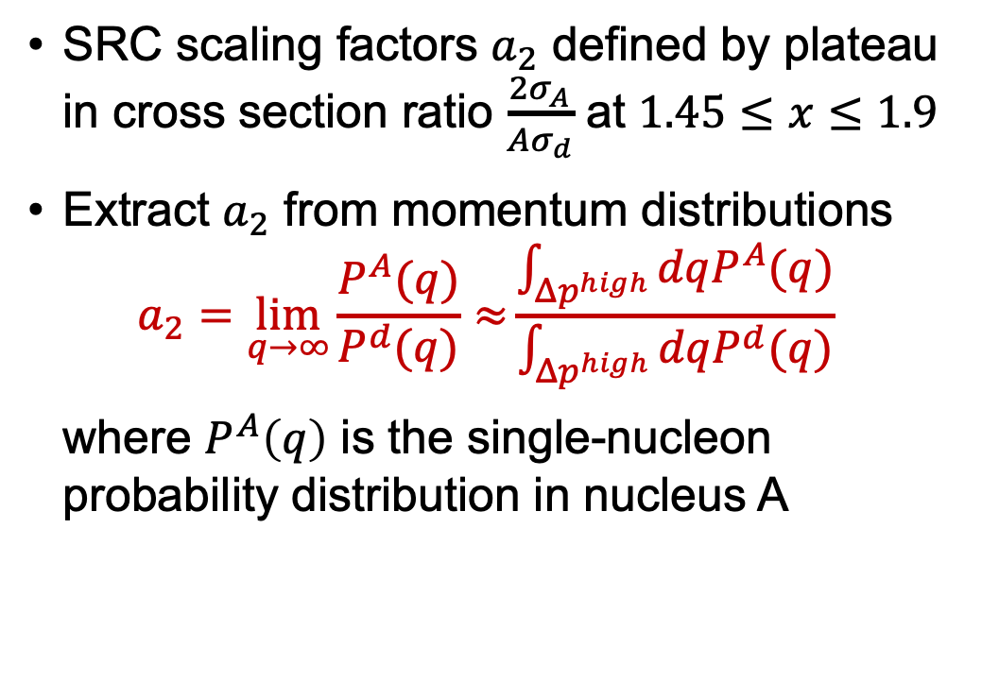
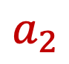
SRC scaling factors
SRC scaling factors $a_{2}$ defined by plateau in cross section ratio $\frac{2σ_{A}}{Aσ_{d}}$ at $1.45≤x≤1.9$
Extract $a_{2}$ from momentum distributions
$$a_{2}=\lim_{q→∞}{\frac{P^{A}(q)}{P^{d}(q)}≈}\frac{\int_{Δp^{high}}{dqP^{A}(q)}}{\int_{Δp^{high}}{dqP^{d}(q)}}$$
where $P^{A}\left(q\right)$ is the single-nucleon probability distribution in nucleus A
$$a_{2}$$
Fig. 4: Ratio of per-nucleon electron scattering cross section of nucleus A to that of deuterium, where the red line indicates a constant fit. Figure from B. Schmookler et al. (CLAS), Nature 566, 354 (2019).
Notes:
SRC scaling factors determined by constant plateau in cross section ratios of A/d indicated by this red line for several nuclei.
We can produce SRC scale factors using momentum distributions at high momentum.

Slide 20
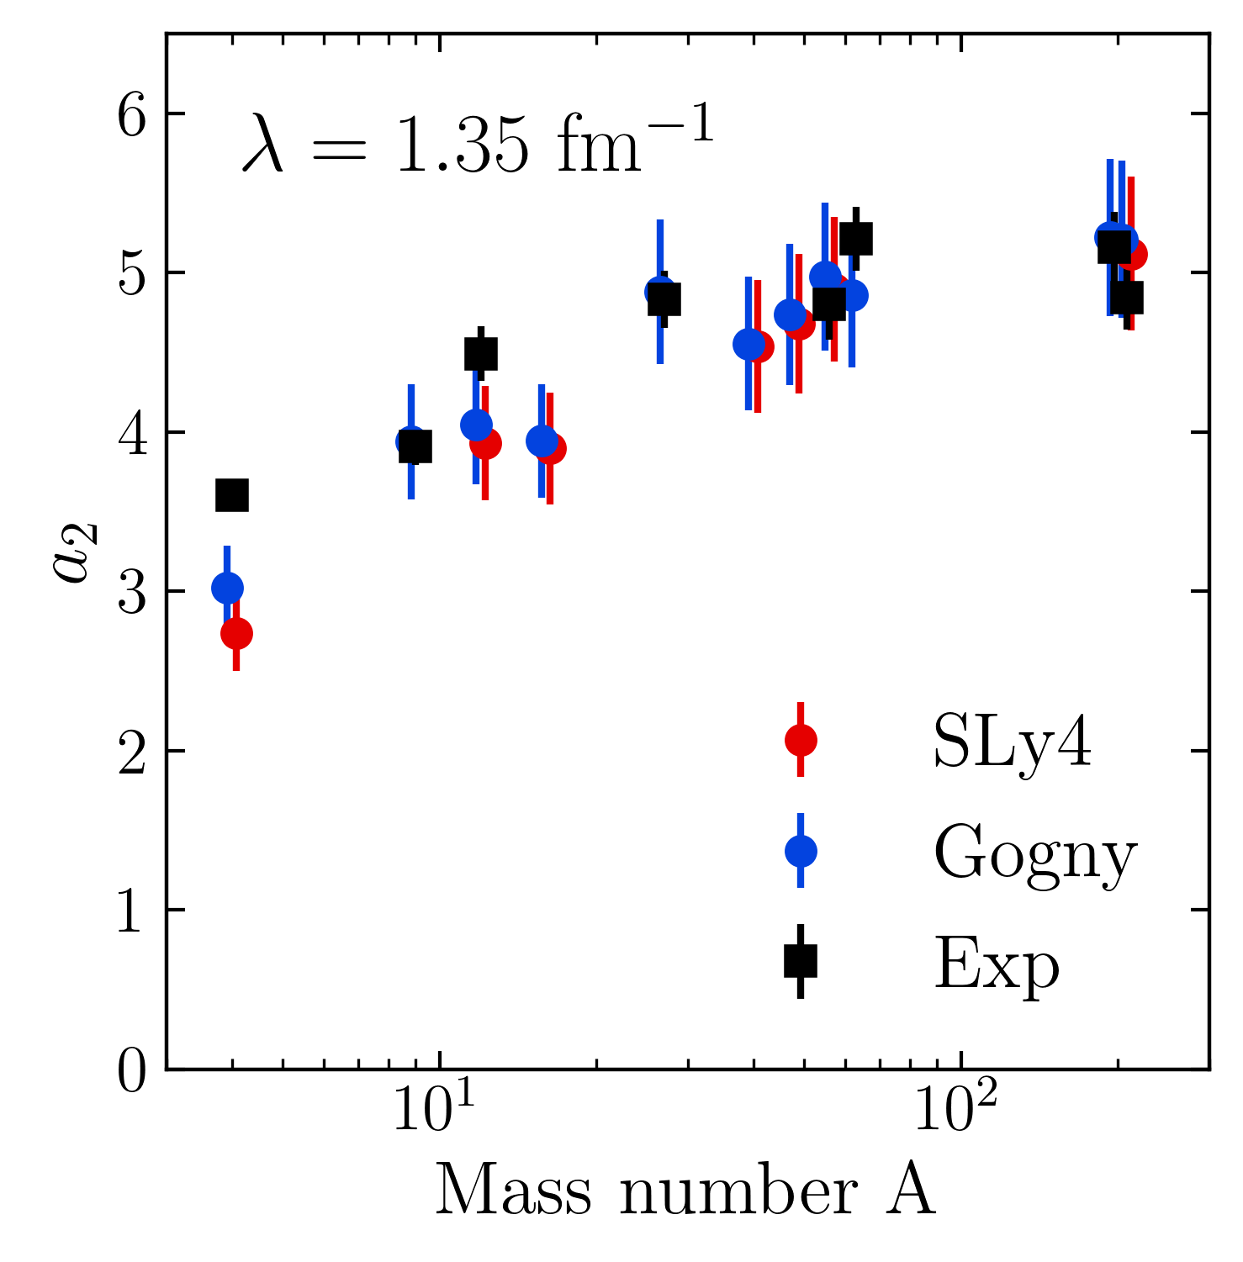
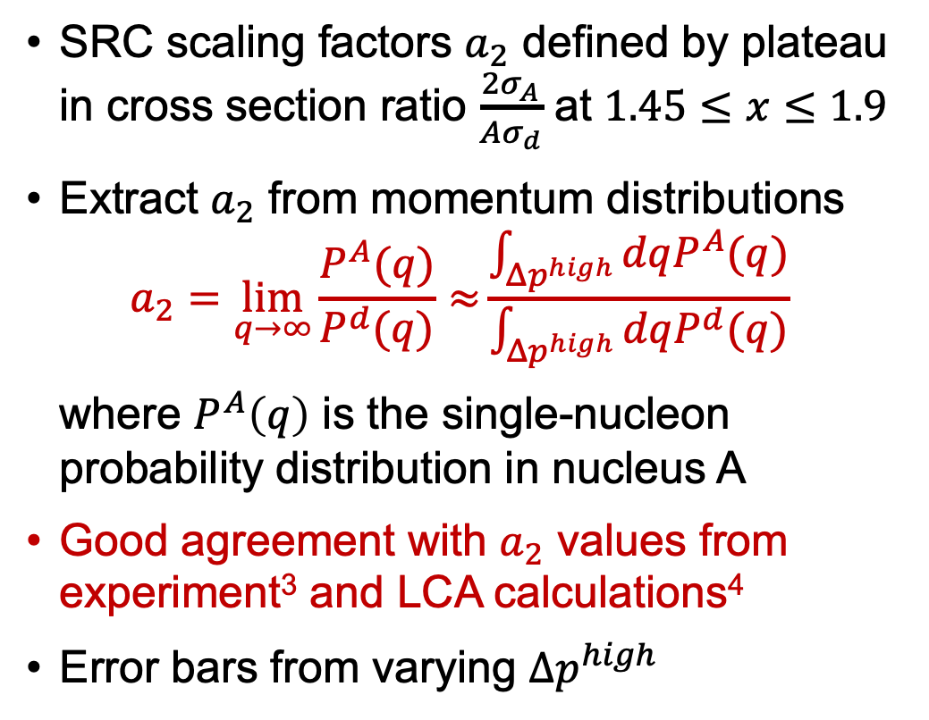
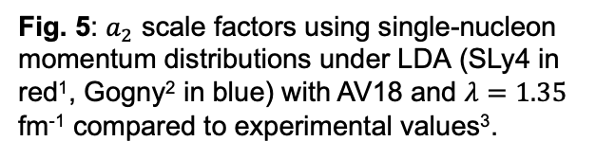
SRC scaling factors
¹E. Chabanat et al., Nucl. Phys. A 635, 231 (1998)
²J. Decharge et al., Phys. Rev. C 21, 1568 (1980)
³B. Schmookler et al. (CLAS), Nature 566, 354 (2019)
⁴J. Ryckebusch et al., Phys. Rev. C 100, 054620 (2019)
SRC scaling factors $a_{2}$ defined by plateau in cross section ratio $\frac{2σ_{A}}{Aσ_{d}}$ at $1.45≤x≤1.9$
Extract $a_{2}$ from momentum distributions
$$a_{2}=\lim_{q→∞}{\frac{P^{A}(q)}{P^{d}(q)}≈}\frac{\int_{Δp^{high}}{dqP^{A}(q)}}{\int_{Δp^{high}}{dqP^{d}(q)}}$$
where $P^{A}\left(q\right)$ is the single-nucleon probability distribution in nucleus A
Good agreement with $a_{2}$ values from experiment³ and LCA calculations⁴
Error bars from varying $Δp^{high}$
Fig. 5: $a_{2}$ scale factors using single-nucleon momentum distributions under LDA (SLy4 in red¹, Gogny² in blue) with AV18 and $λ=1.35$ fm⁻¹ compared to experimental values³.
Notes:
Gives good agreement with experiment and LCA calculations from this reference (point) using two different EDFs.
a2 is extracted from inclusive cross section ratios of \sigma^A / \sigma^d which plateau at high Bjorken x.

Slide 21
SRC phenomenology
np includes ¹S₀ and ³S₁-³D₁
Scalar limit
At high RG resolution, the tensor force and the repulsive core of the NN interaction kicks nucleon pairs into SRCs
np dominates because the tensor force requires spin triplet pairs (pp are spin singlets)
Do we describe this physics at low RG resolution?
Fig. 6: (a) Ratio of two-nucleon to single-nucleon electron-scattering cross sections for carbon as a function of missing momentum. (b) Fraction of np to p and pp to p pairs versus the relative momentum. Figure from CLAS collaboration publication¹.
¹I. Korover et al. (CLAS), arXiv:2004.07304 (2014)
Notes:
Don't bother describing (a) - just say these are cross section ratios on the left, on the right are the pair fraction of proton-neutron and proton-proton.
The takeaway is at high RG resolution, the tensor force… (fast!)

Slide 22
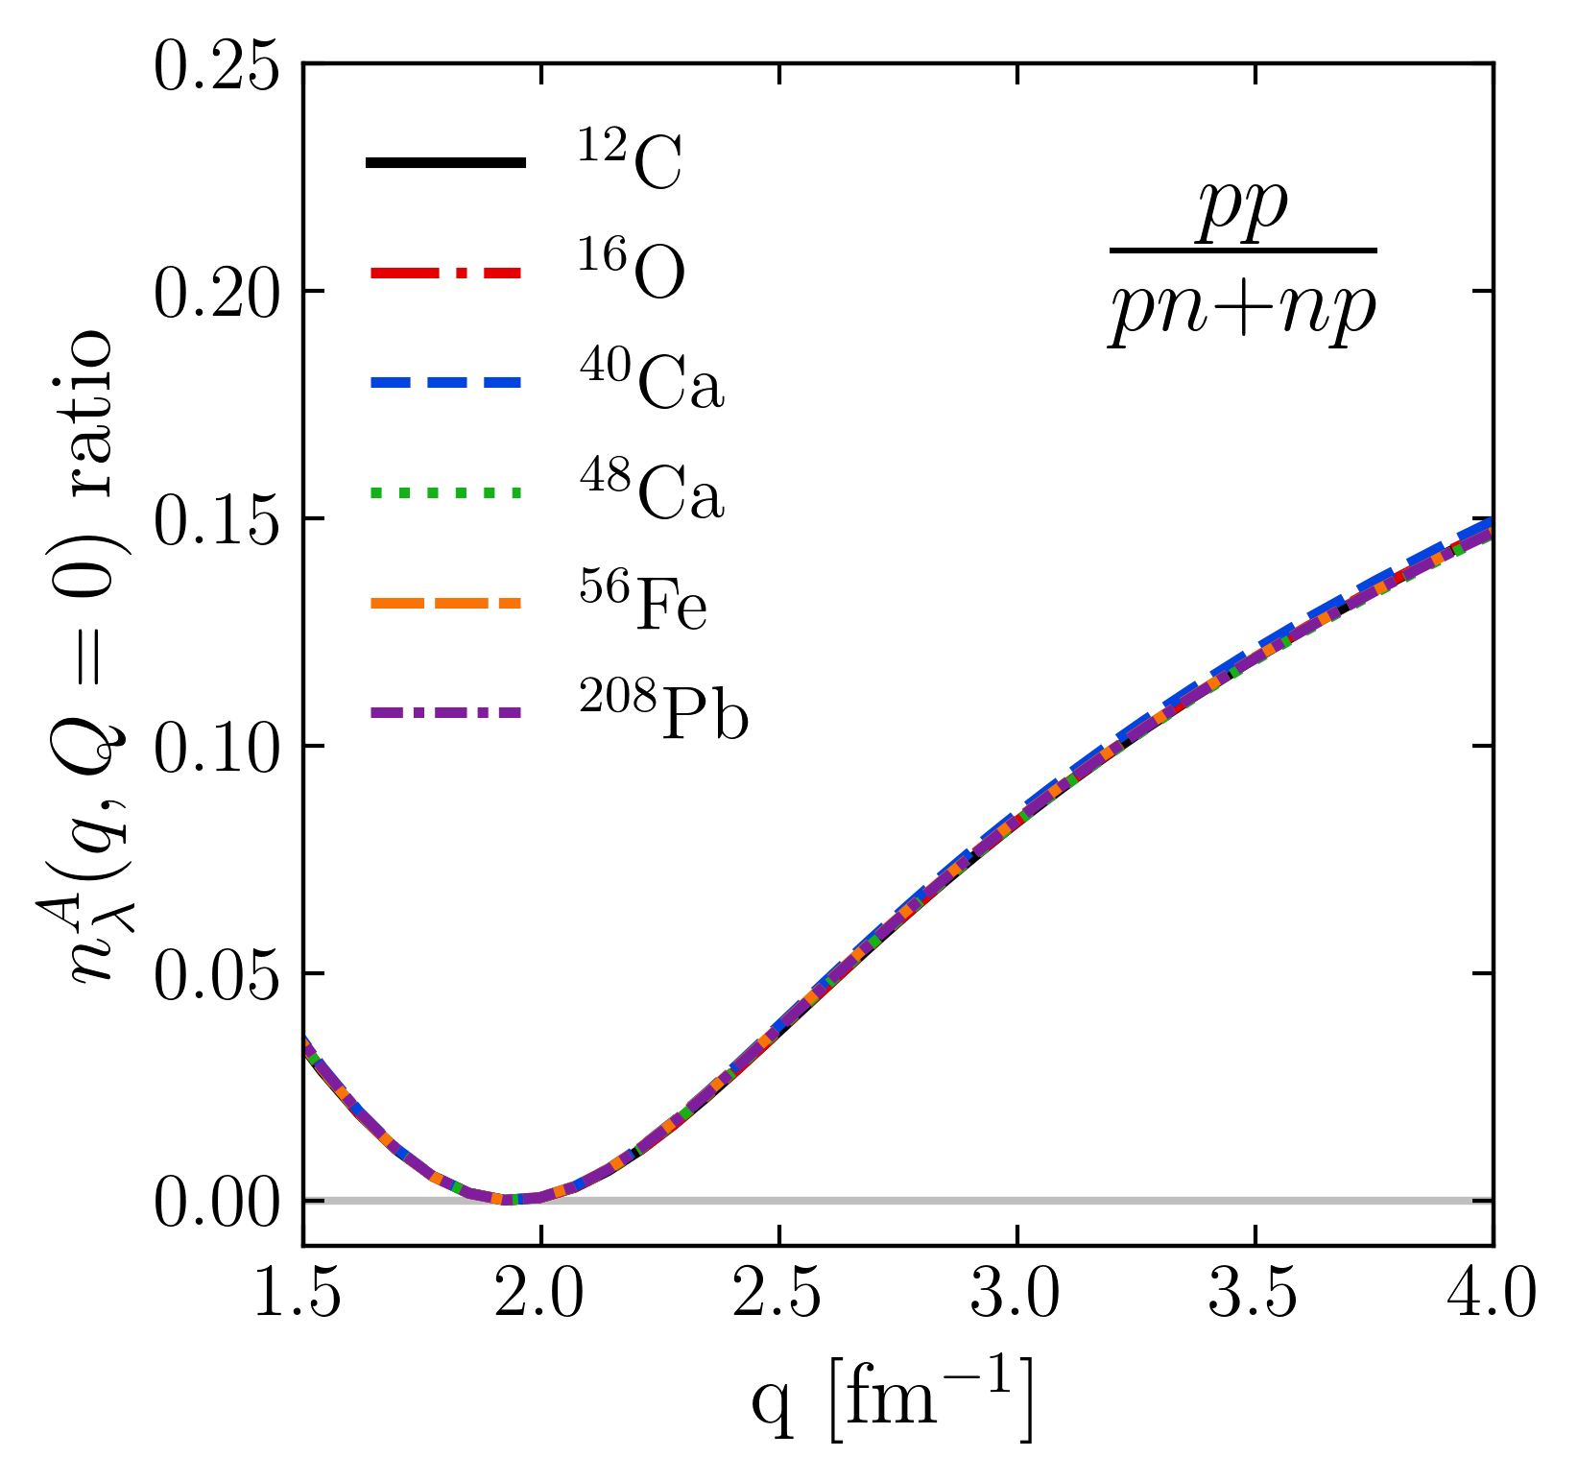
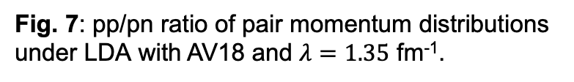
SRC phenomenology
np includes ¹S₀ and ³S₁-³D₁
Scalar limit
At low RG resolution, SRCs are suppressed in the wave function and shifted into the operator
Physics is established in the 2-body system – can apply to any nucleus!
Low RG resolution picture reproduces the characteristics of cross section ratios using simple approximations
pn dominance
Scalar limit
Fig. 7: pp/pn ratio of pair momentum distributions under LDA with AV18 and $λ=1.35$ fm⁻¹.
Notes:
Explain first two bullets.
So if we calculate the ratio of the momentum distributions for pp/np, we reproduce the general results where we see the pn dominance at 400 MeV and transition to the scalar limit.

Slide 23
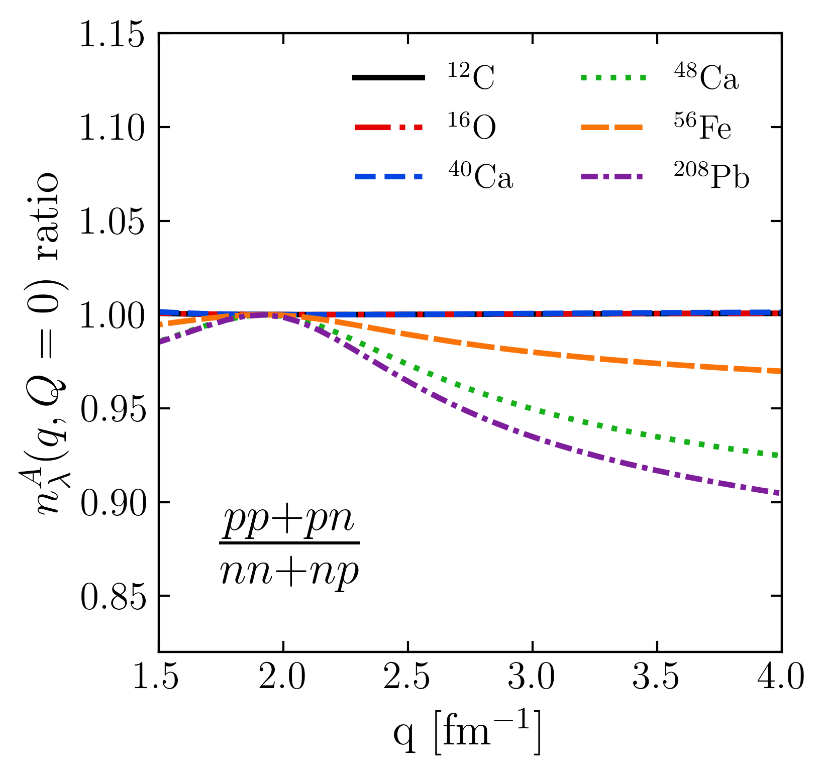
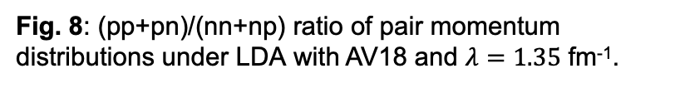
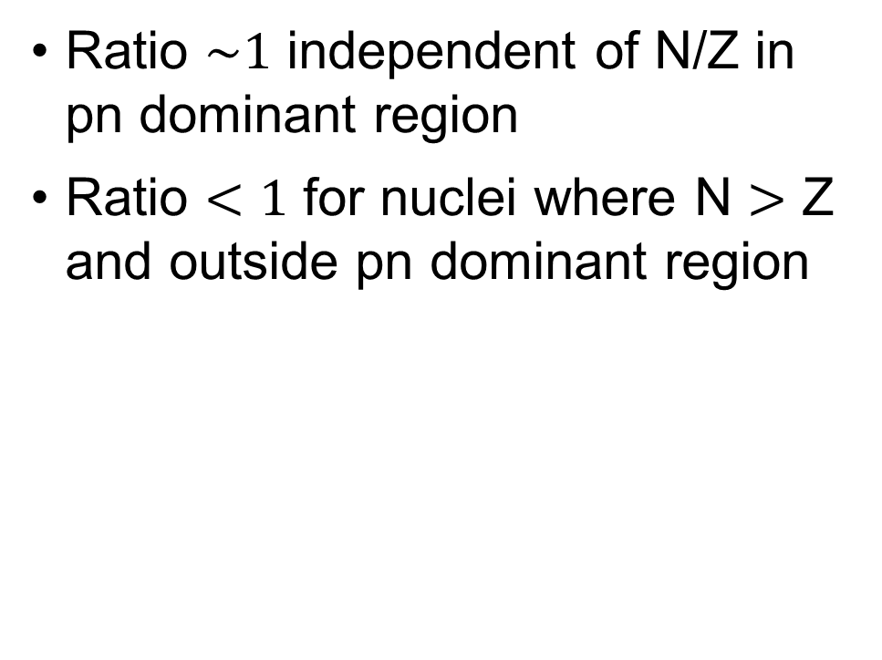
SRC phenomenology
Ratio $\sim 1$ independent of N/Z in pn dominant region
Ratio $<1$ for nuclei where N $>$ Z and outside pn dominant region
pn dominance
Fig. 8: (pp+pn)/(nn+np) ratio of pair momentum distributions under LDA with AV18 and $λ=1.35$ fm⁻¹.
Notes:
We can also look at isospin dependence: by taking ratios we see the pn-dominant region is independent of N/Z while the scalar limits depends on N/Z.

Slide 24
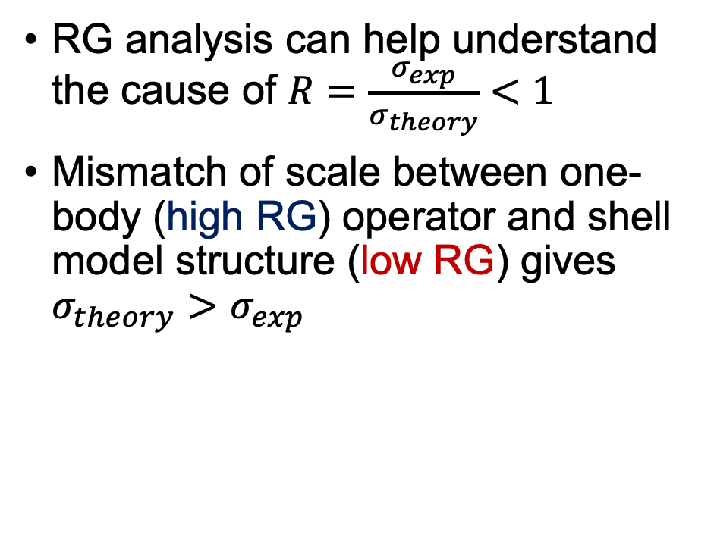
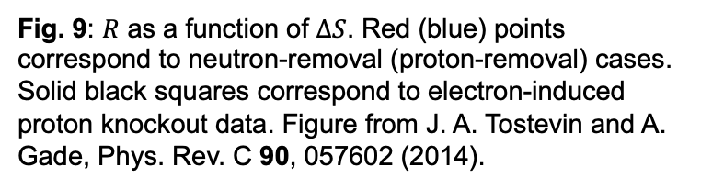
Other exclusive knockout reactions
RG analysis can help understand the cause of $R=\frac{σ_{exp}}{σ_{theory}}<1$
Mismatch of scale between one-body (high RG) operator and shell model structure (low RG) gives $σ_{theory}>σ_{exp}$
Fig. 9: $R$ as a function of $∆S$. Red (blue) points correspond to neutron-removal (proton-removal) cases. Solid black squares correspond to electron-induced proton knockout data. Figure from J. A. Tostevin and A. Gade, Phys. Rev. C 90, 057602 (2014).
Notes:
One of the future directions of this is to look at other exclusive knockout reactions.
Explain picture: here is a plot showing the ratio of experimental over theory cross sections as a function of \Delta S, which is defined in terms of nucleon separation energies.
We see the ratio is less than one and lowers as \Delta S increases.
The origin of this is not understood but could be stemming from the (second bullet).

Slide 25
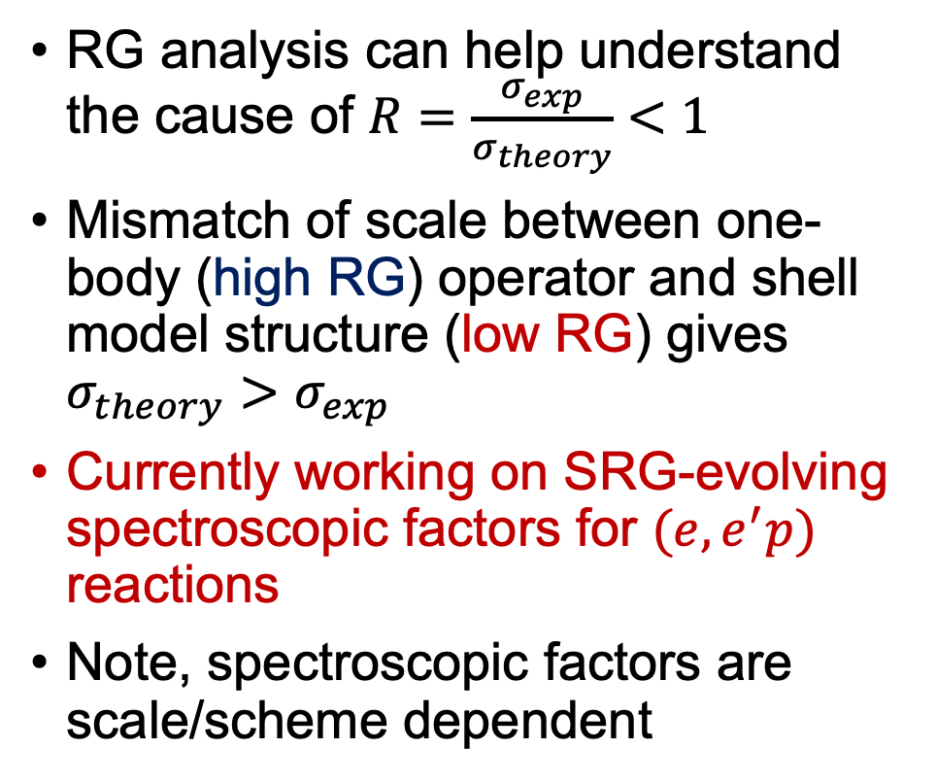

Other exclusive knockout reactions
RG analysis can help understand the cause of $R=\frac{σ_{exp}}{σ_{theory}}<1$
Mismatch of scale between one-body (high RG) operator and shell model structure (low RG) gives $σ_{theory}>σ_{exp}$
Currently working on SRG-evolving spectroscopic factors for $(e,e^{′}p)$ reactions
Note, spectroscopic factors are scale/scheme dependent
In progress
Fig. 9: $R$ as a function of $∆S$. Red (blue) points correspond to neutron-removal (proton-removal) cases. Solid black squares correspond to electron-induced proton knockout data. Figure from J. A. Tostevin and A. Gade, Phys. Rev. C 90, 057602 (2014).
Notes:
Currently working on SRG-evolving spectroscopic factors for (e,e’p) reactions.
Note, SFs are scale/scheme dependent so using the RG is the correct way for analyzing them.

Slide 26
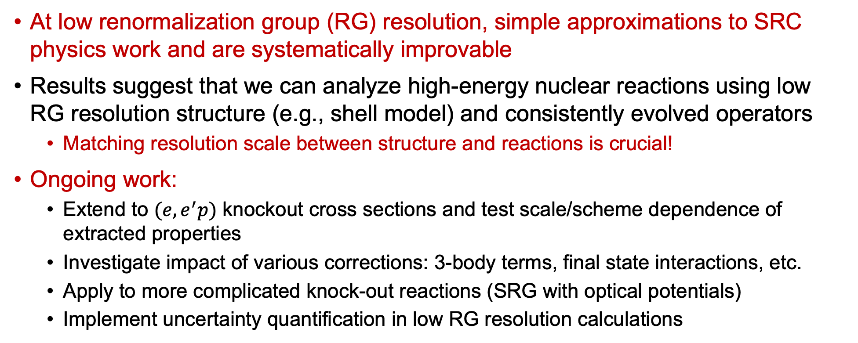
Summary and outlook
At low renormalization group (RG) resolution, simple approximations to SRC physics work and are systematically improvable
Results suggest that we can analyze high-energy nuclear reactions using low RG resolution structure (e.g., shell model) and consistently evolved operators
Matching resolution scale between structure and reactions is crucial!
Ongoing work:
Extend to $(e,e^{′}p)$ knockout cross sections and test scale/scheme dependence of extracted properties
Investigate impact of various corrections: 3-body terms, final state interactions, etc.
Apply to more complicated knock-out reactions (SRG with optical potentials)
Implement uncertainty quantification in low RG resolution calculations

Slide 27
Extras

Slide 28
Extras
Fig. 10: Cartoon snapshots of a nucleus at (left) low-RG and (right) high-RG resolutions. The back-to-back nucleons at high-RG resolution are an SRC pair with small center-of-mass momentum.

Slide 29
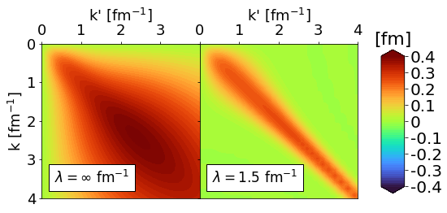
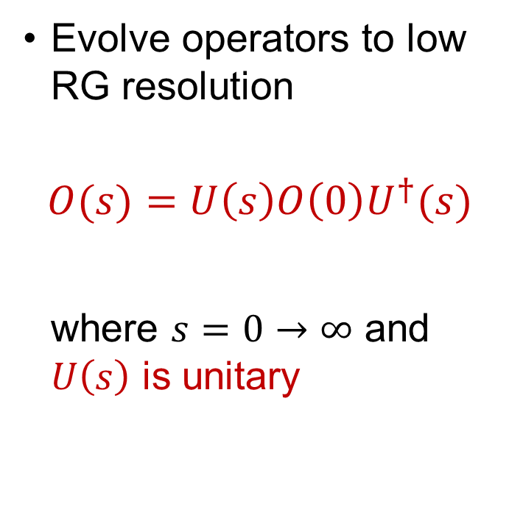
SRG decoupling
Evolve operators to low RG resolution
$$O(s)=U\left(s\right)O\left(0\right)U^{†}(s)$$
where $s=0→∞$ and $U\left(s\right)$ is unitary
Fig. 11: Momentum space matrix elements of Argonne v18 (AV18) under SRG evolution in ¹P₁ channel.

Slide 30
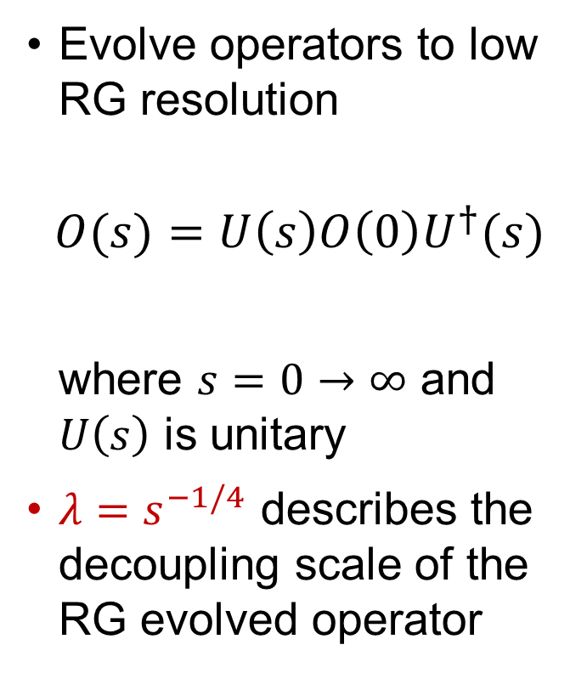
SRG decoupling
Evolve operators to low RG resolution
$$O(s)=U\left(s\right)O\left(0\right)U^{†}(s)$$
where $s=0→∞$ and $U\left(s\right)$ is unitary
$λ=s^{−1/4}$ describes the decoupling scale of the RG evolved operator
Fig. 11: Momentum space matrix elements of Argonne v18 (AV18) under SRG evolution in ¹P₁ channel.

Slide 31
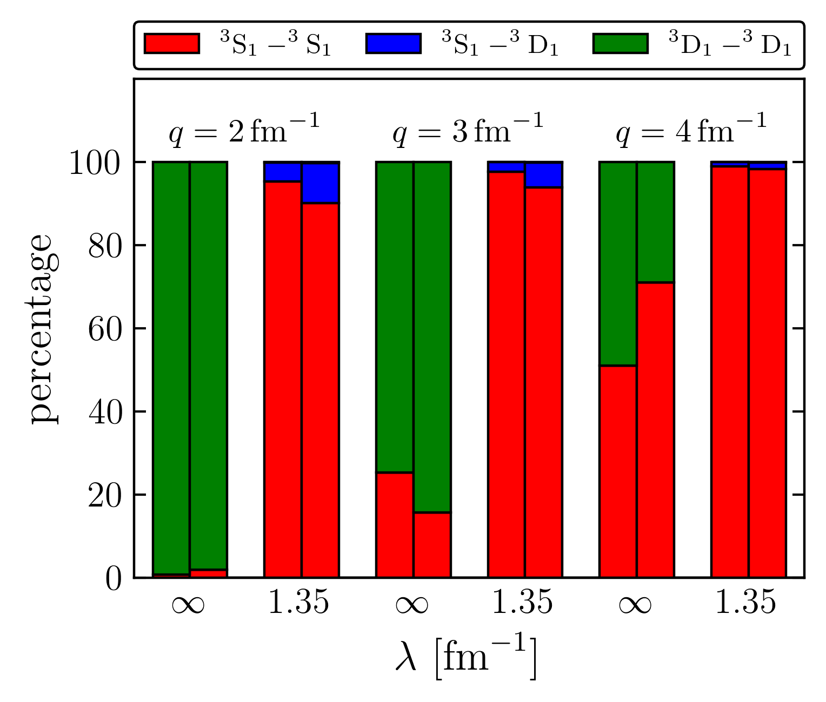
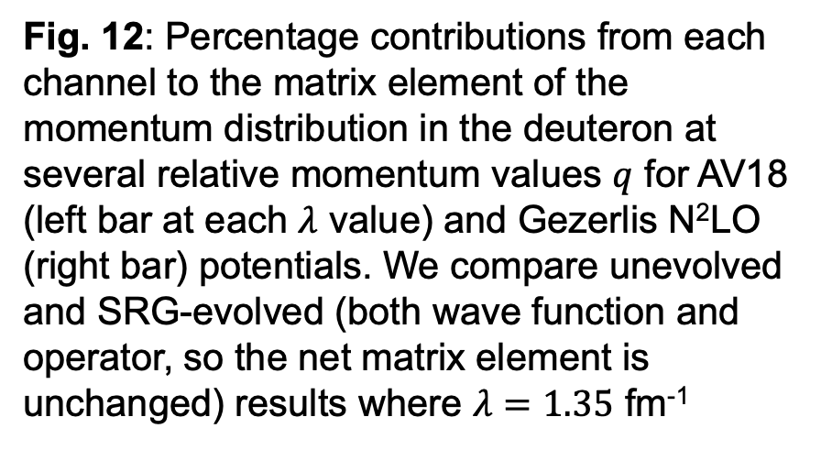
S-state and D-state contributions
Fig. 12: Percentage contributions from each channel to the matrix element of the momentum distribution in the deuteron at several relative momentum values $q$ for AV18 (left bar at each $λ$ value) and Gezerlis N²LO (right bar) potentials. We compare unevolved and SRG-evolved (both wave function and operator, so the net matrix element is unchanged) results where $λ=1.35$ fm⁻¹

Slide 32
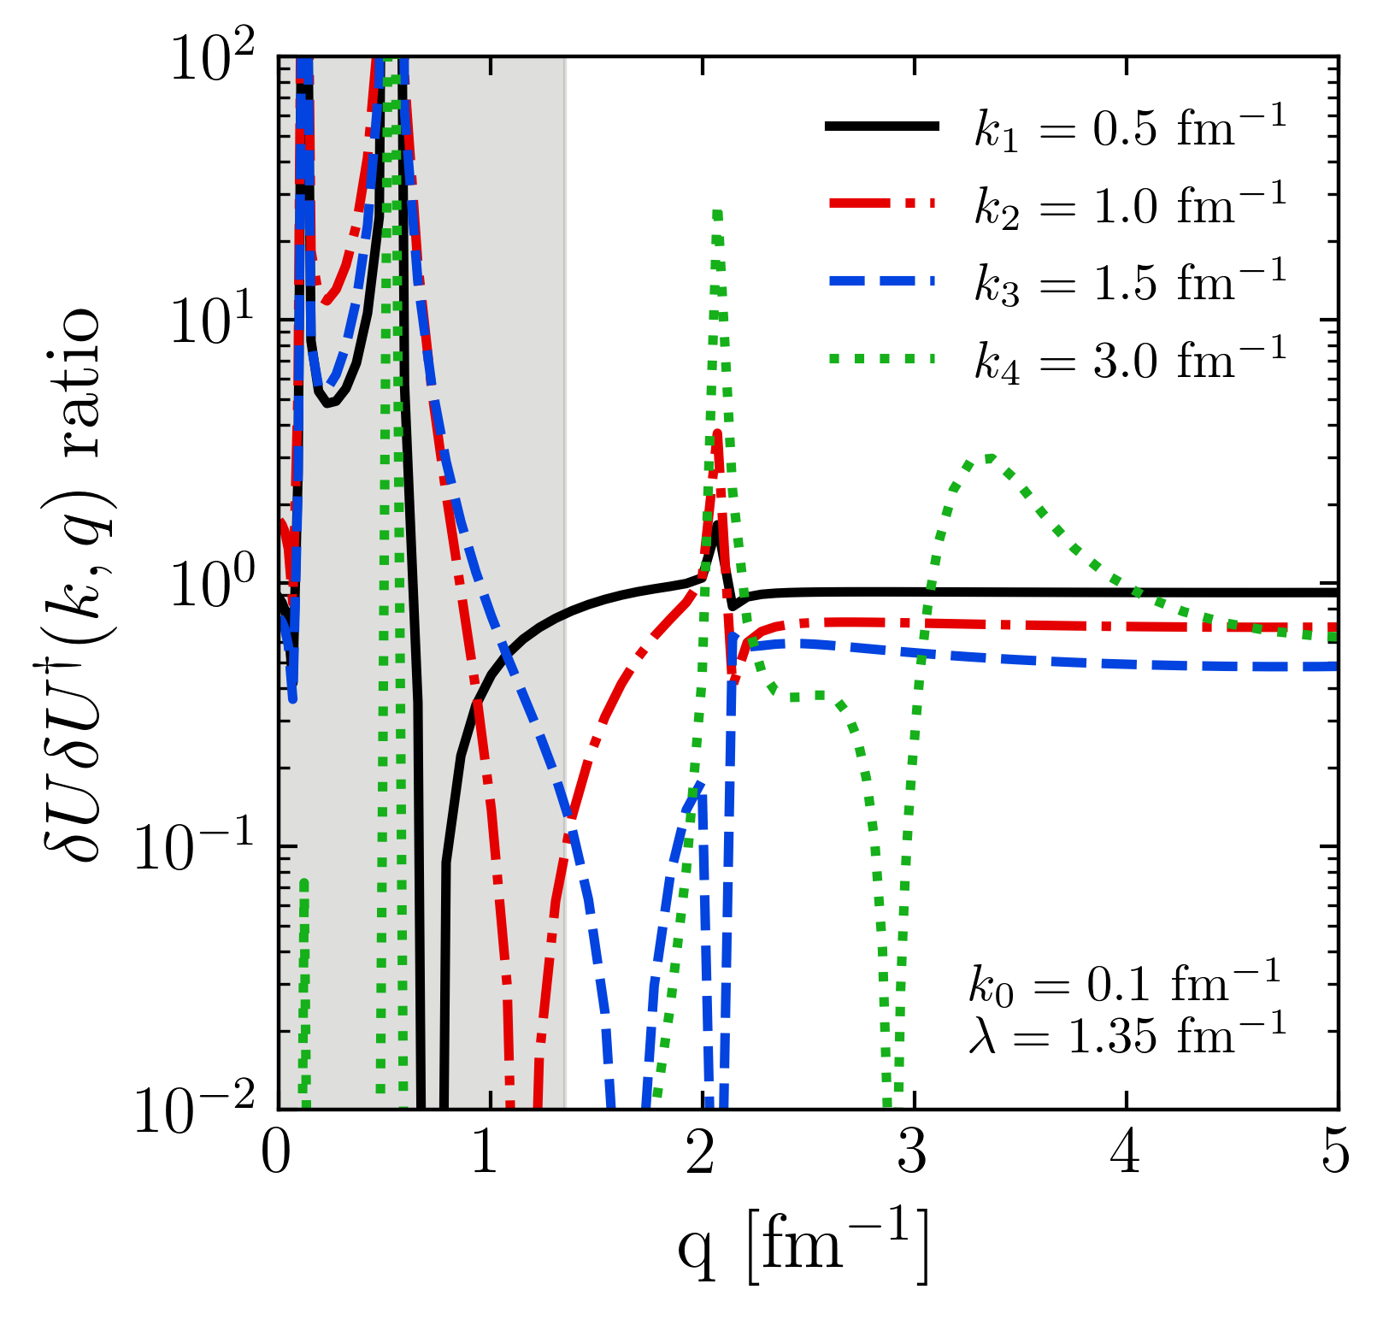
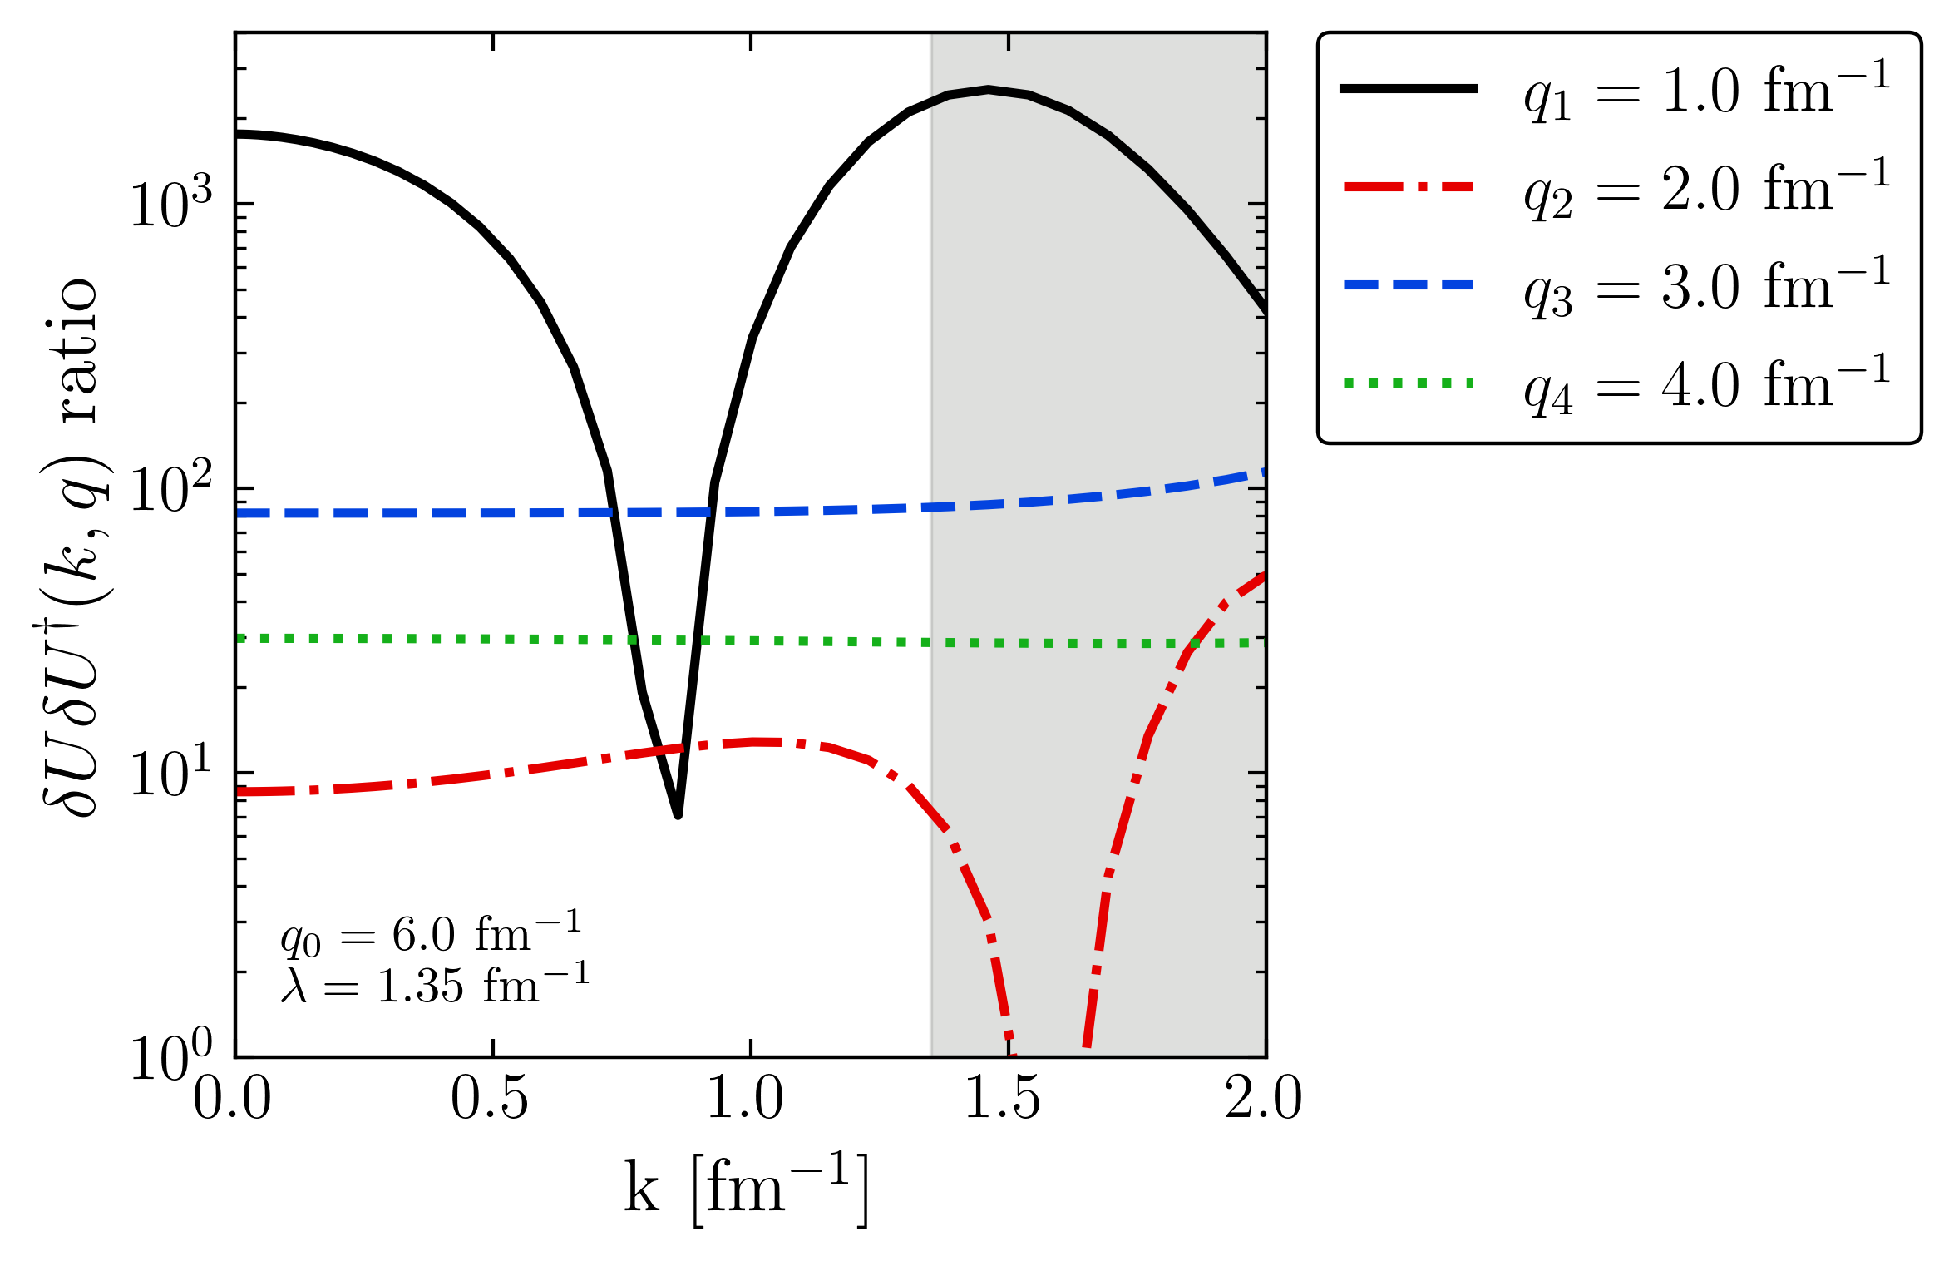
Factorization

Slide 33
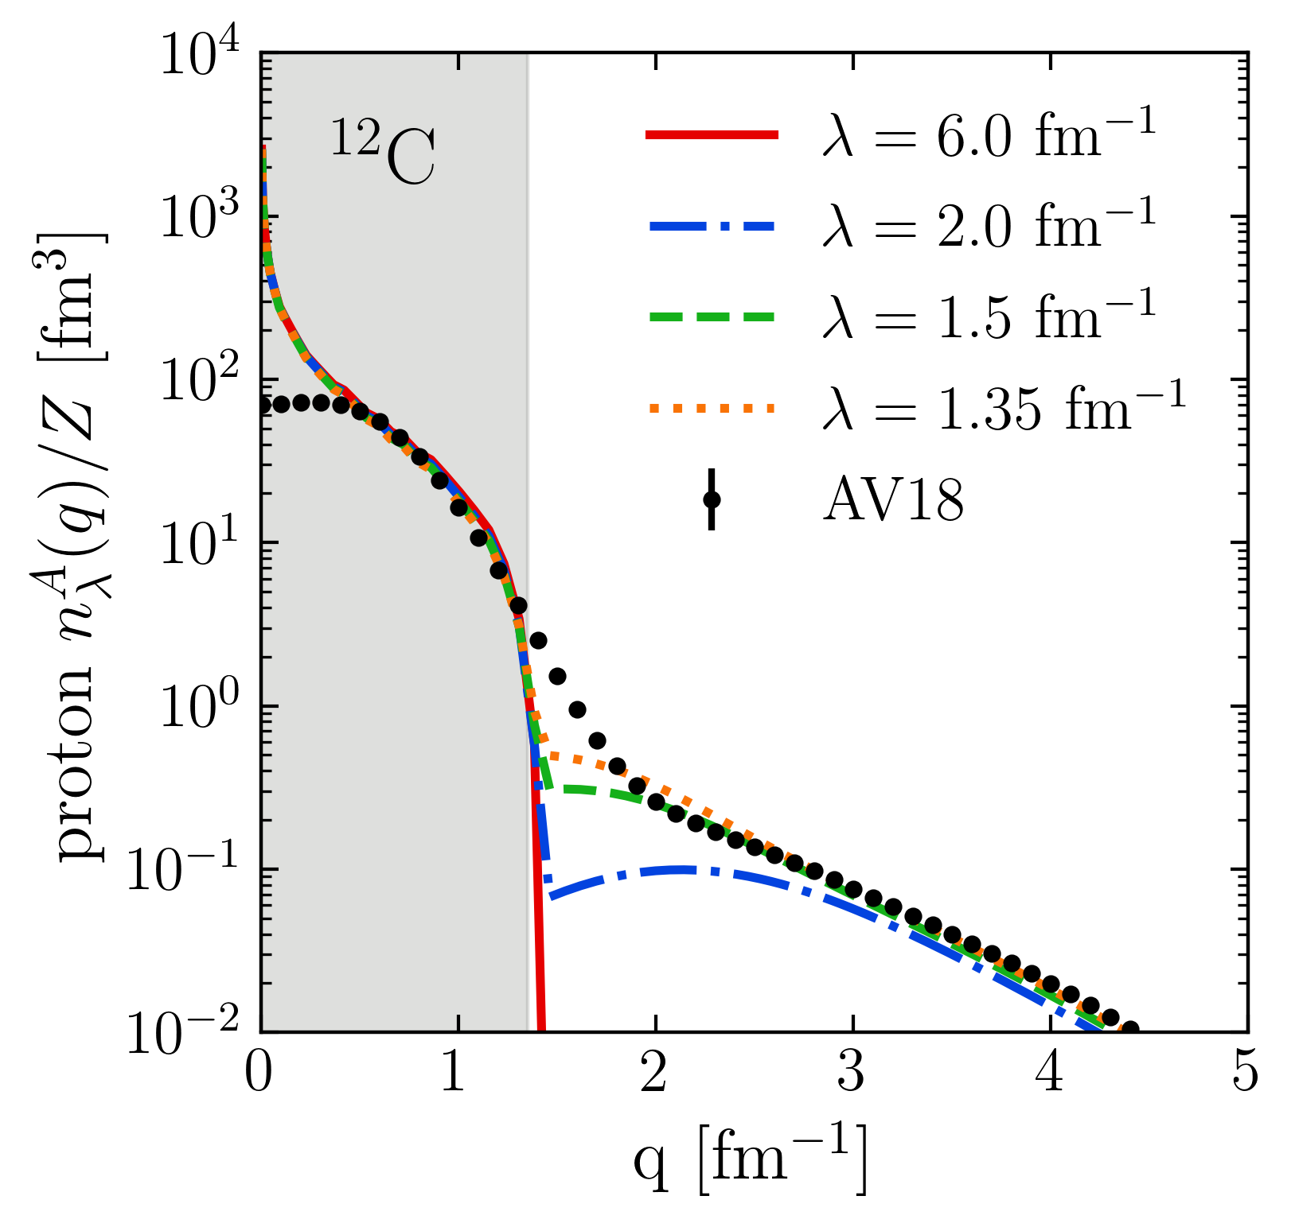
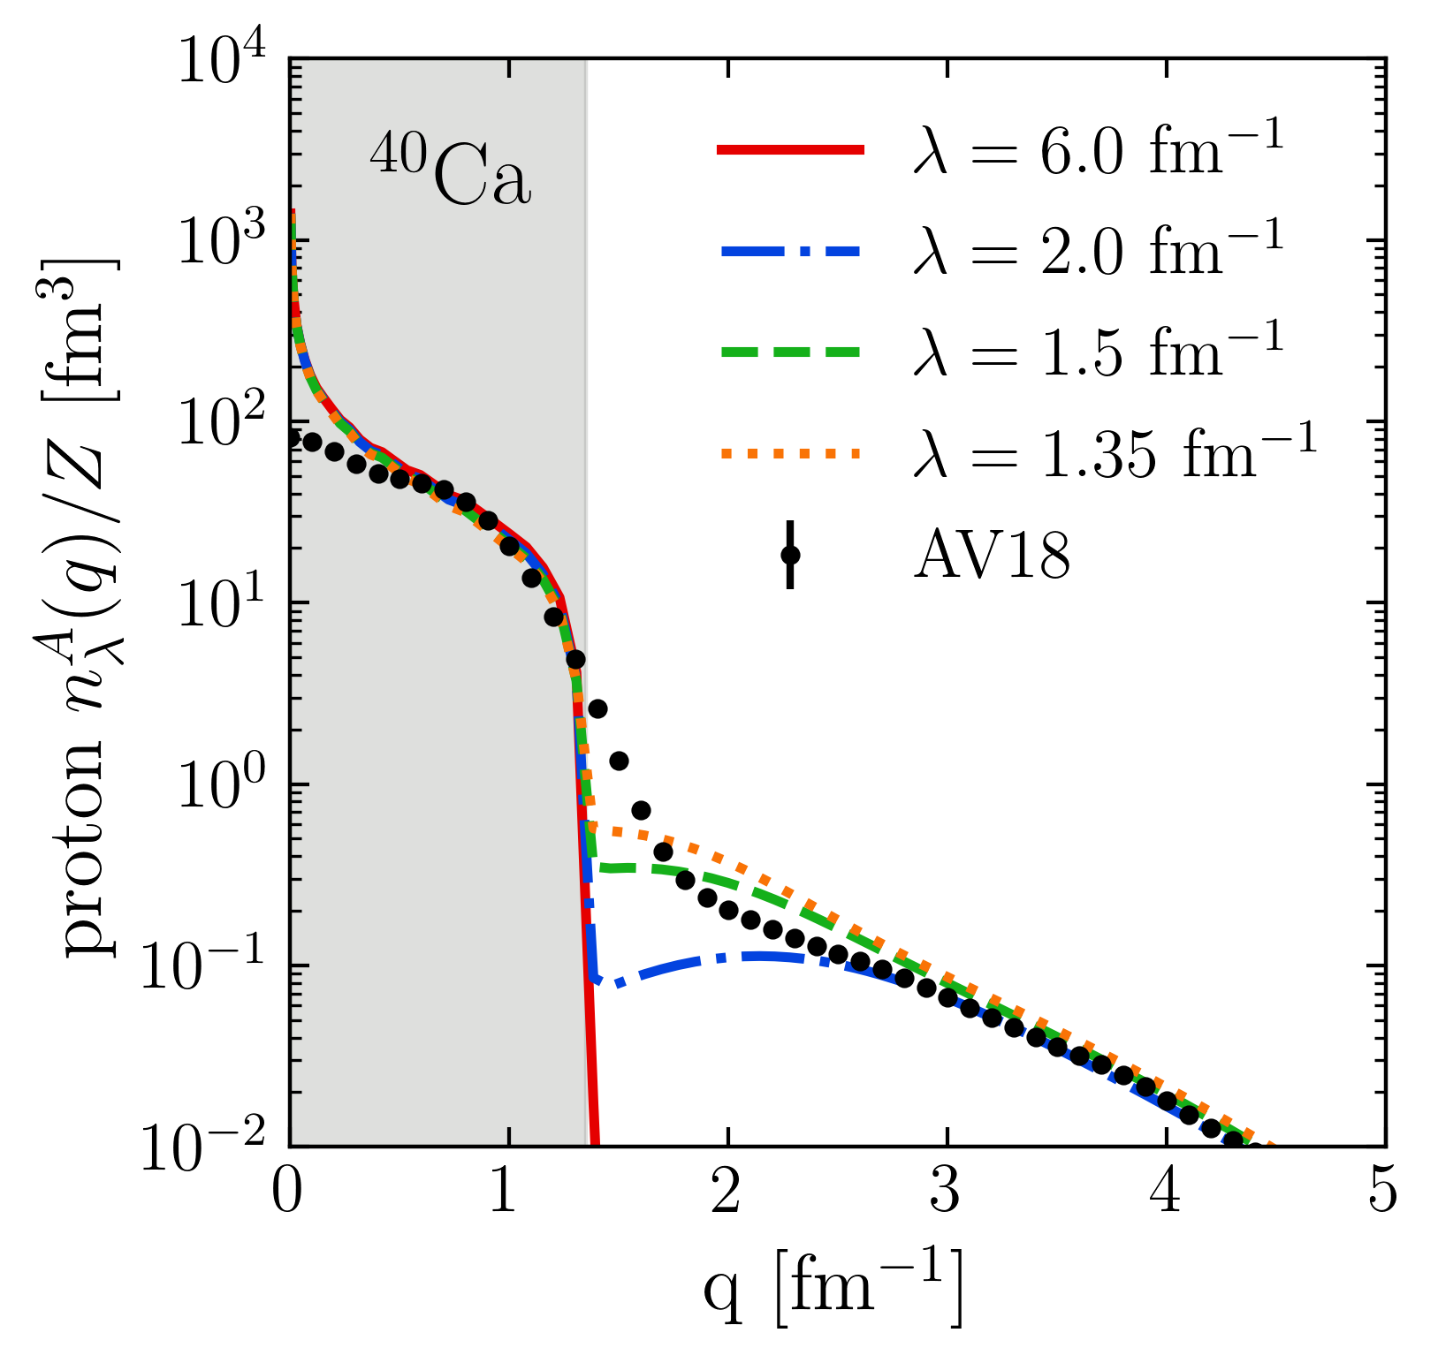

SRG $λ$ dependence in momentum distributions

